Slide 1


Notes:
1

Slide 2

Notes:
2
2
Greetings/additional statements - Title

Slide 3


Notes:
3
(Innate location) In Washington, DC (national capital) in Dupont Circle district
3

Slide 4
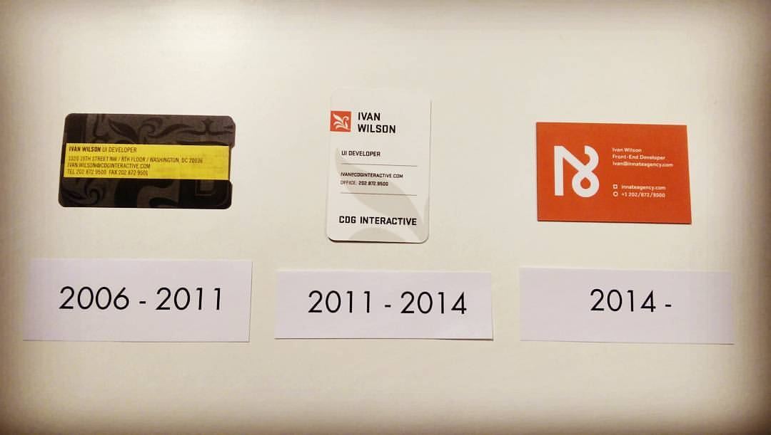
Notes:
4
4
10th Anniversary in April

Slide 5
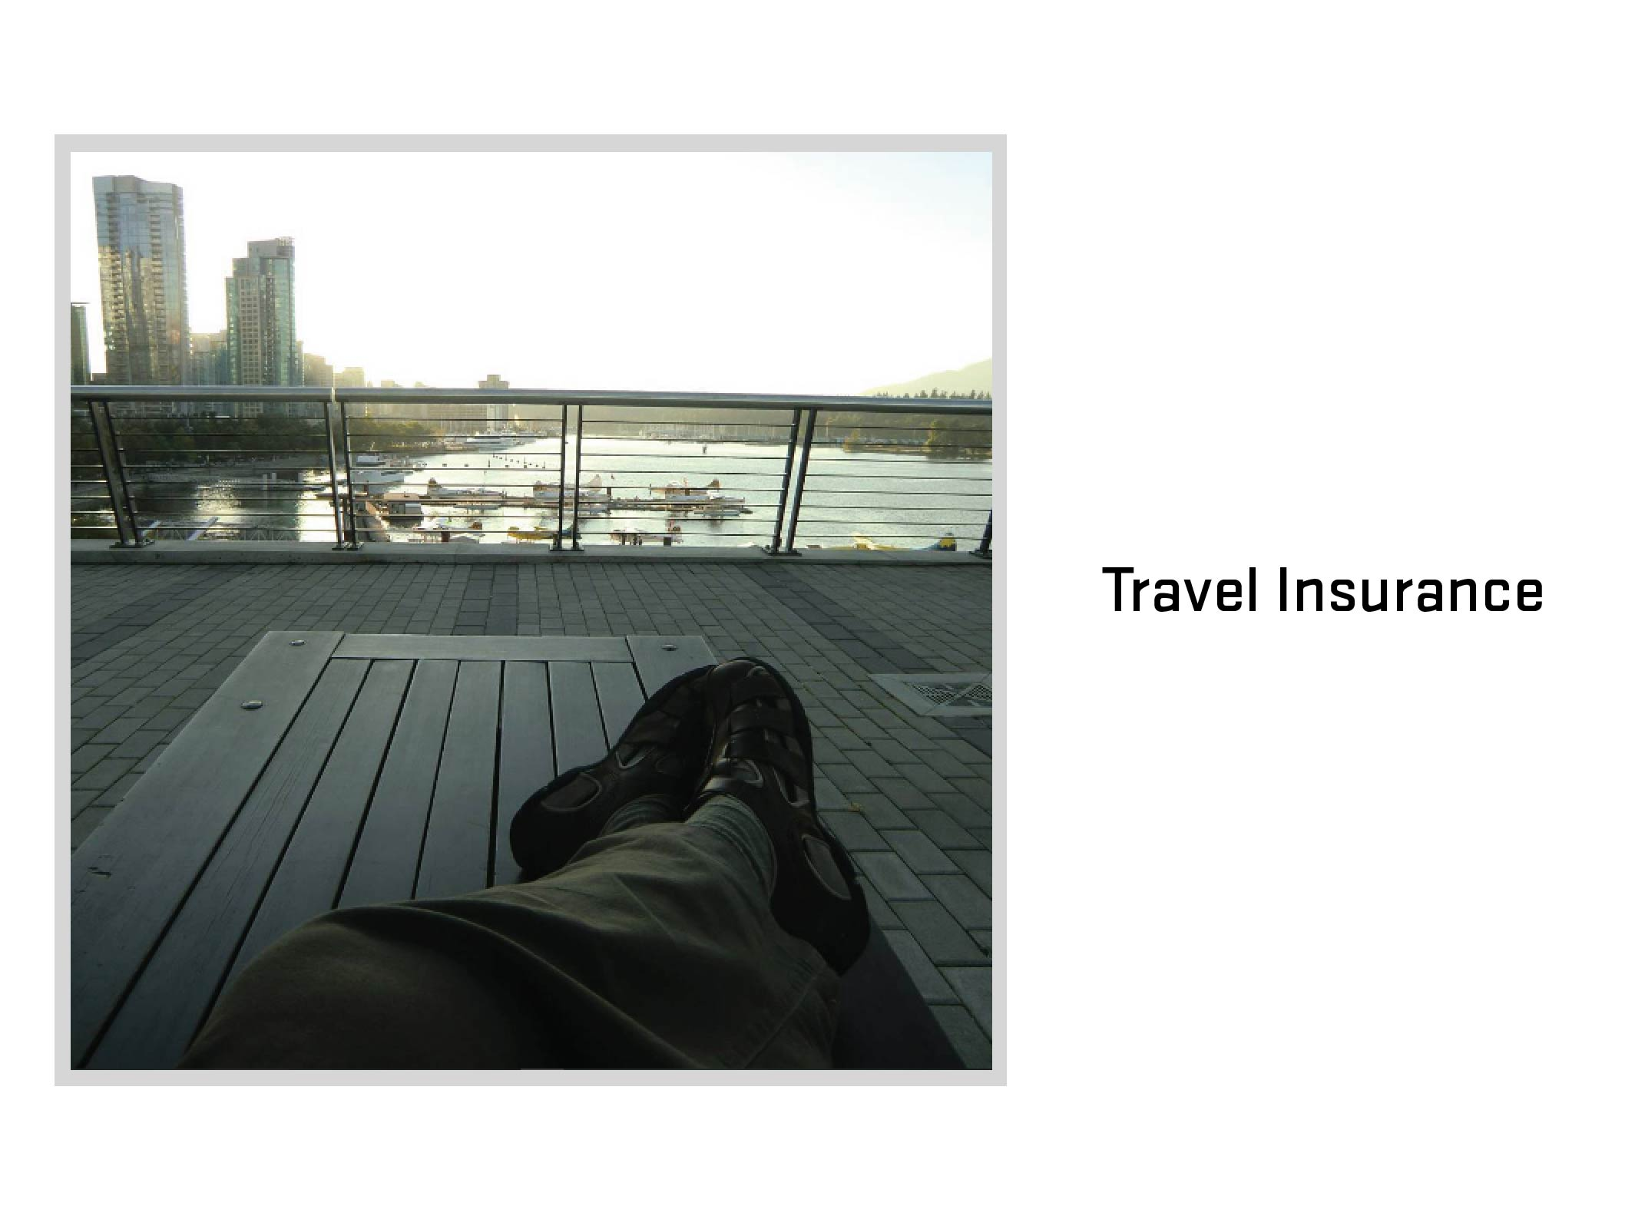
Notes:
5
5
Travel Insurance
What is travel insurance? (Ask audience)

Slide 6
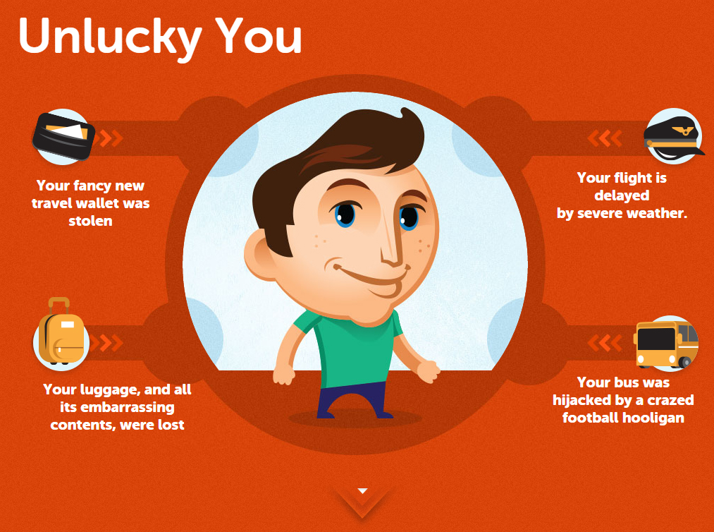
Notes:
6
6

Slide 7
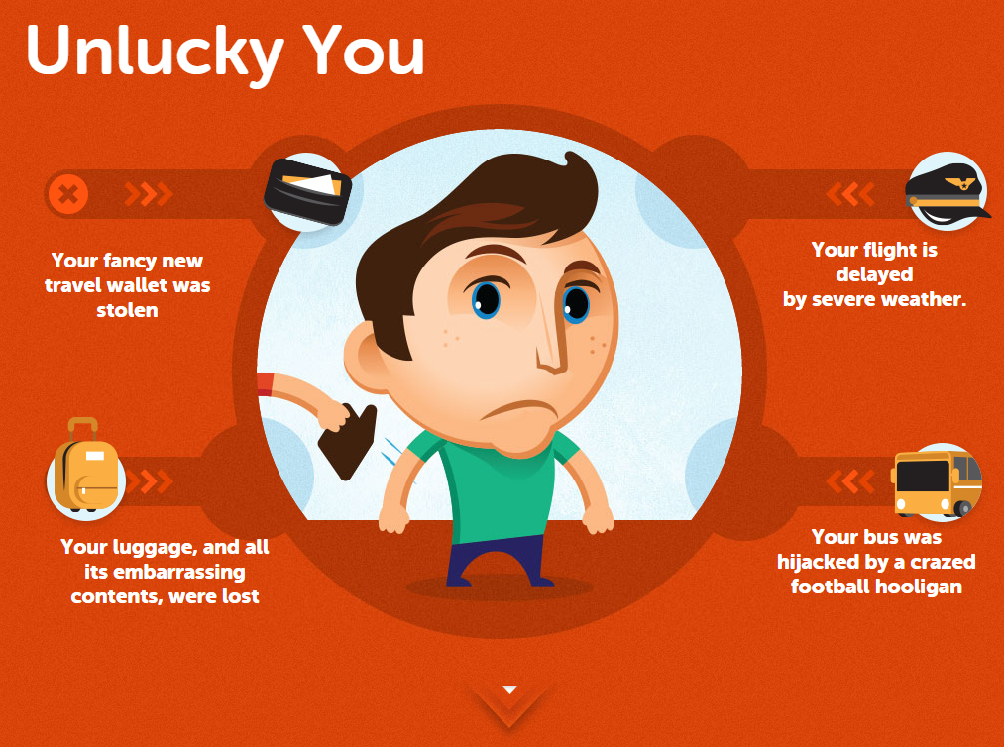
Notes:
7
7

Slide 8
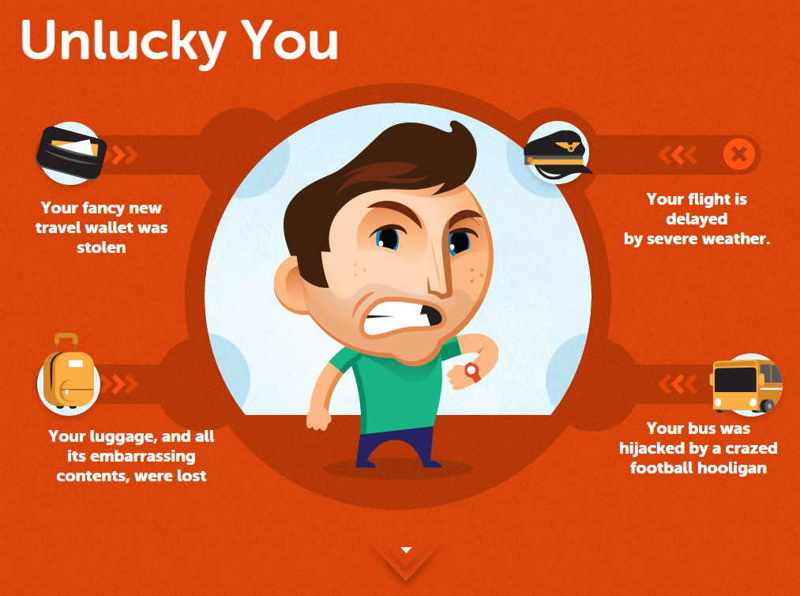
Notes:
8
8

Slide 9
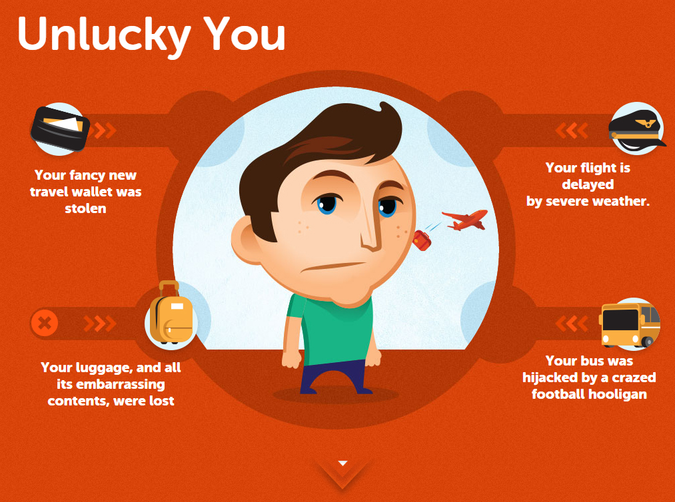
Notes:
9
9

Slide 10
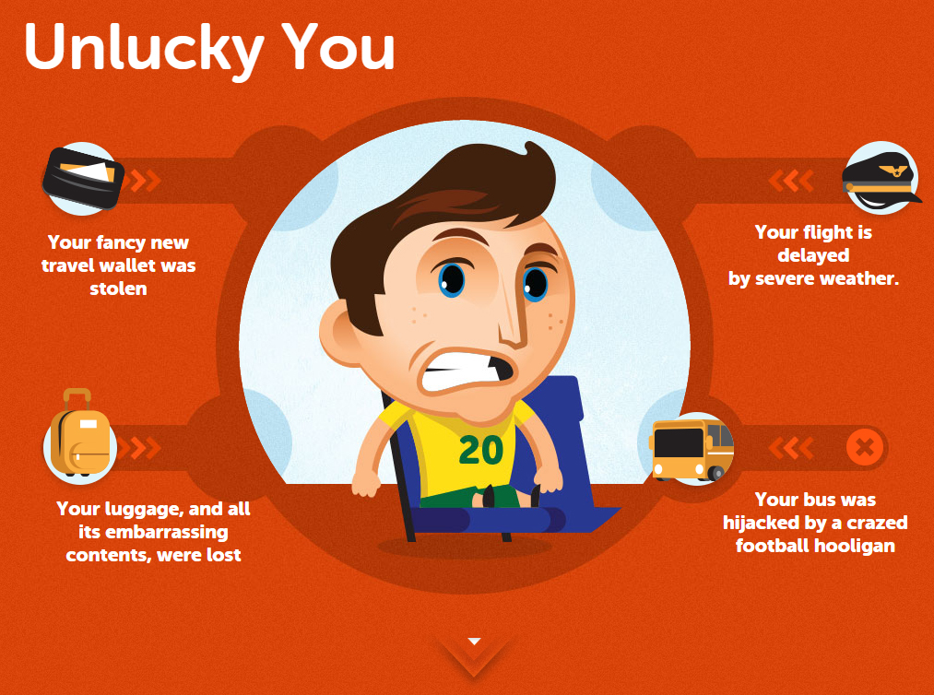
Notes:
10
10

Slide 11
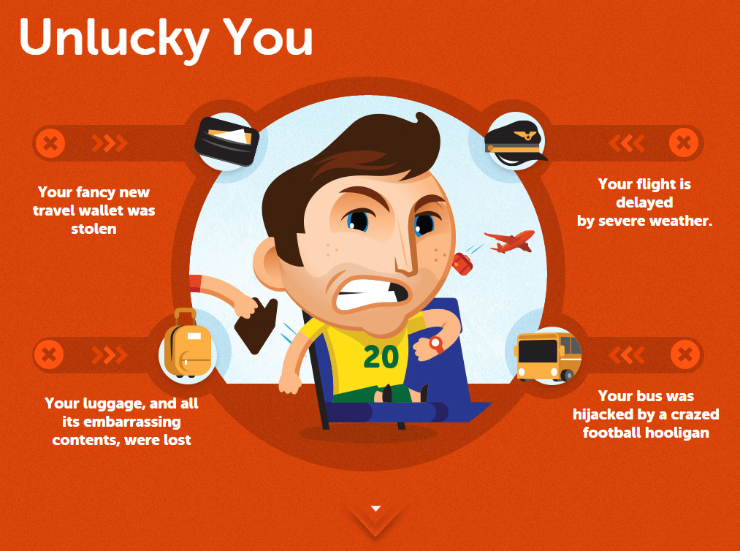
Notes:
11
11

Slide 12

Notes:
12
12

Slide 13
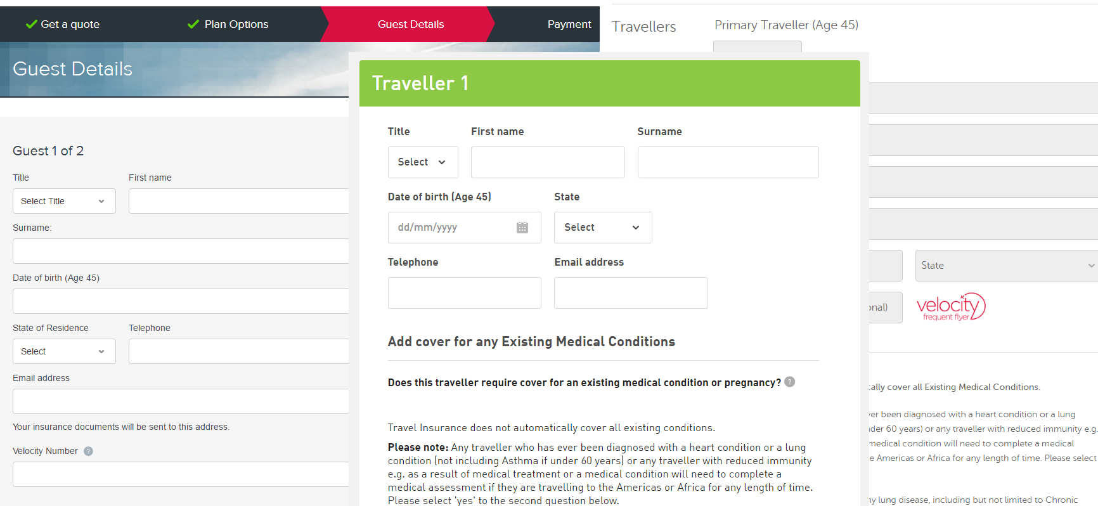
Notes:
13
13

Slide 14
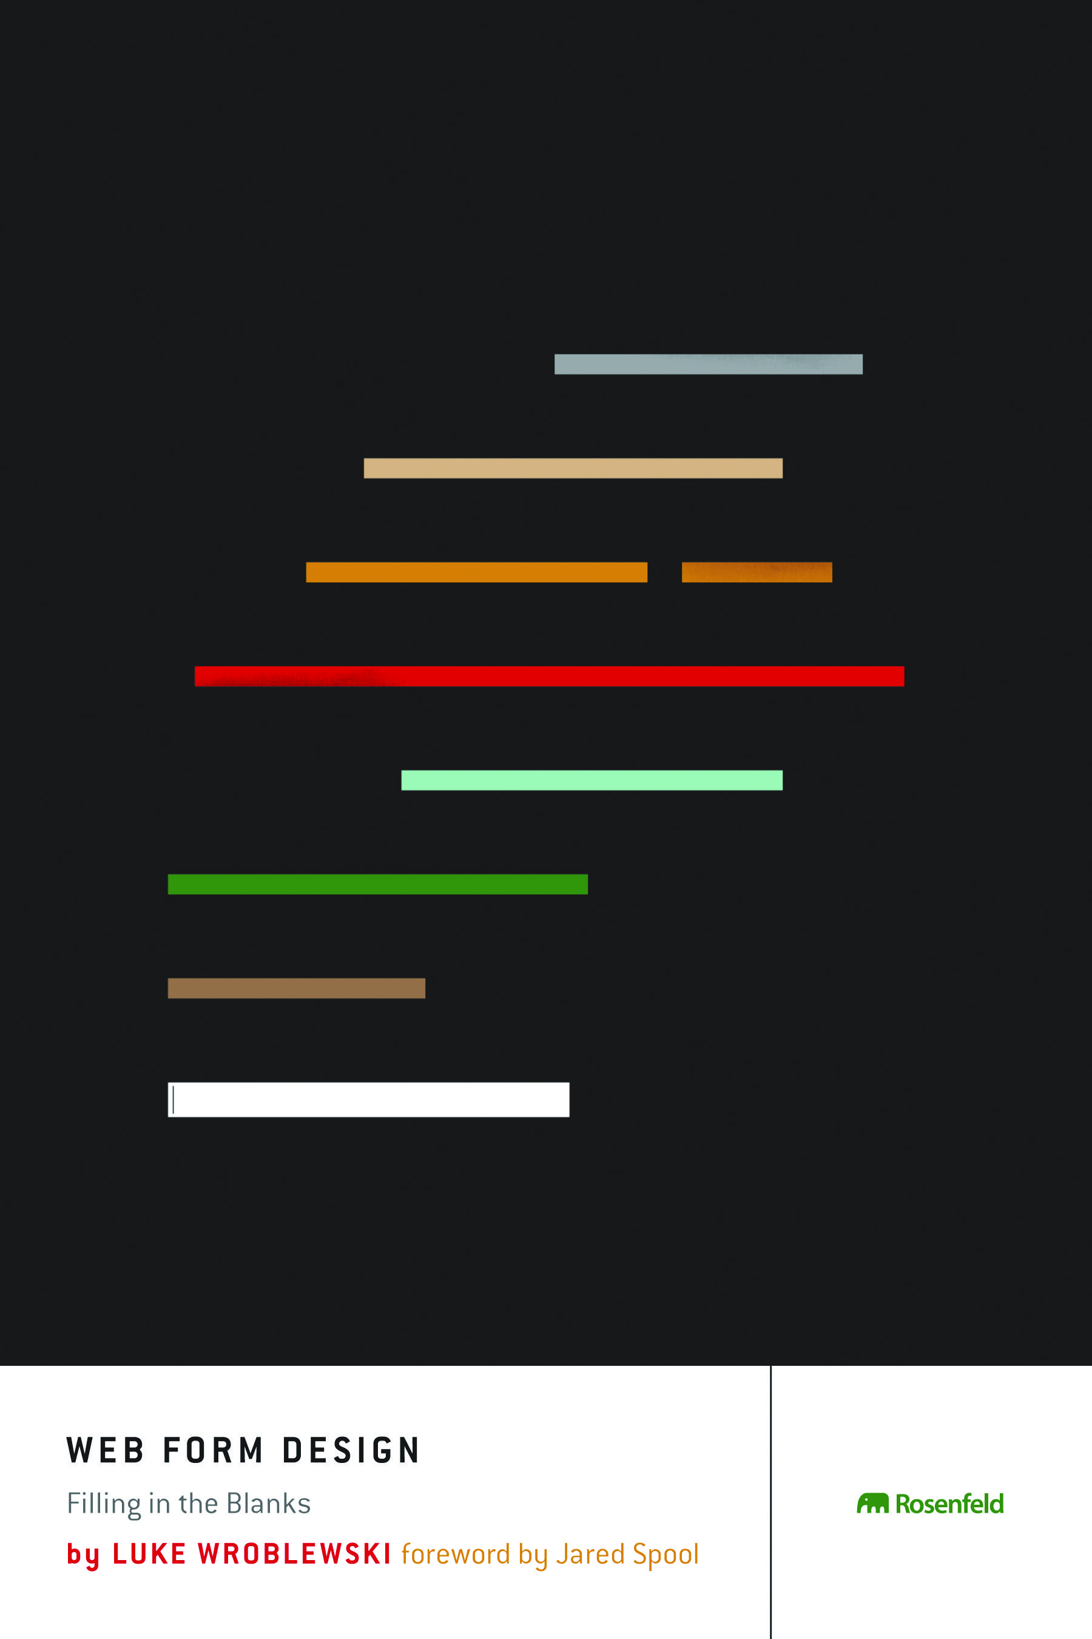
Notes:
14
14

Slide 15
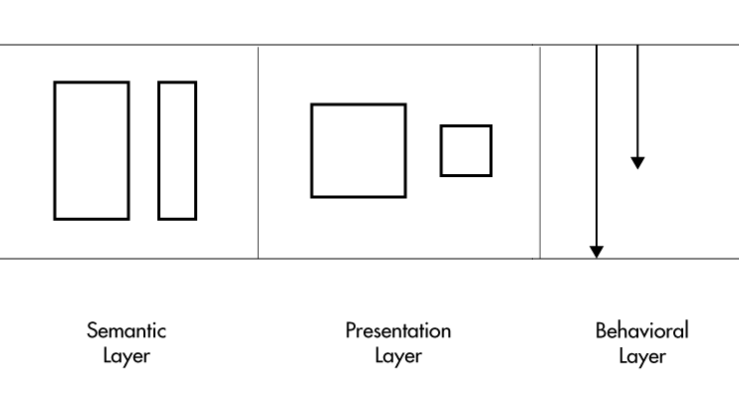
Notes:
15
15

Slide 16

Notes:
16
16

Slide 17
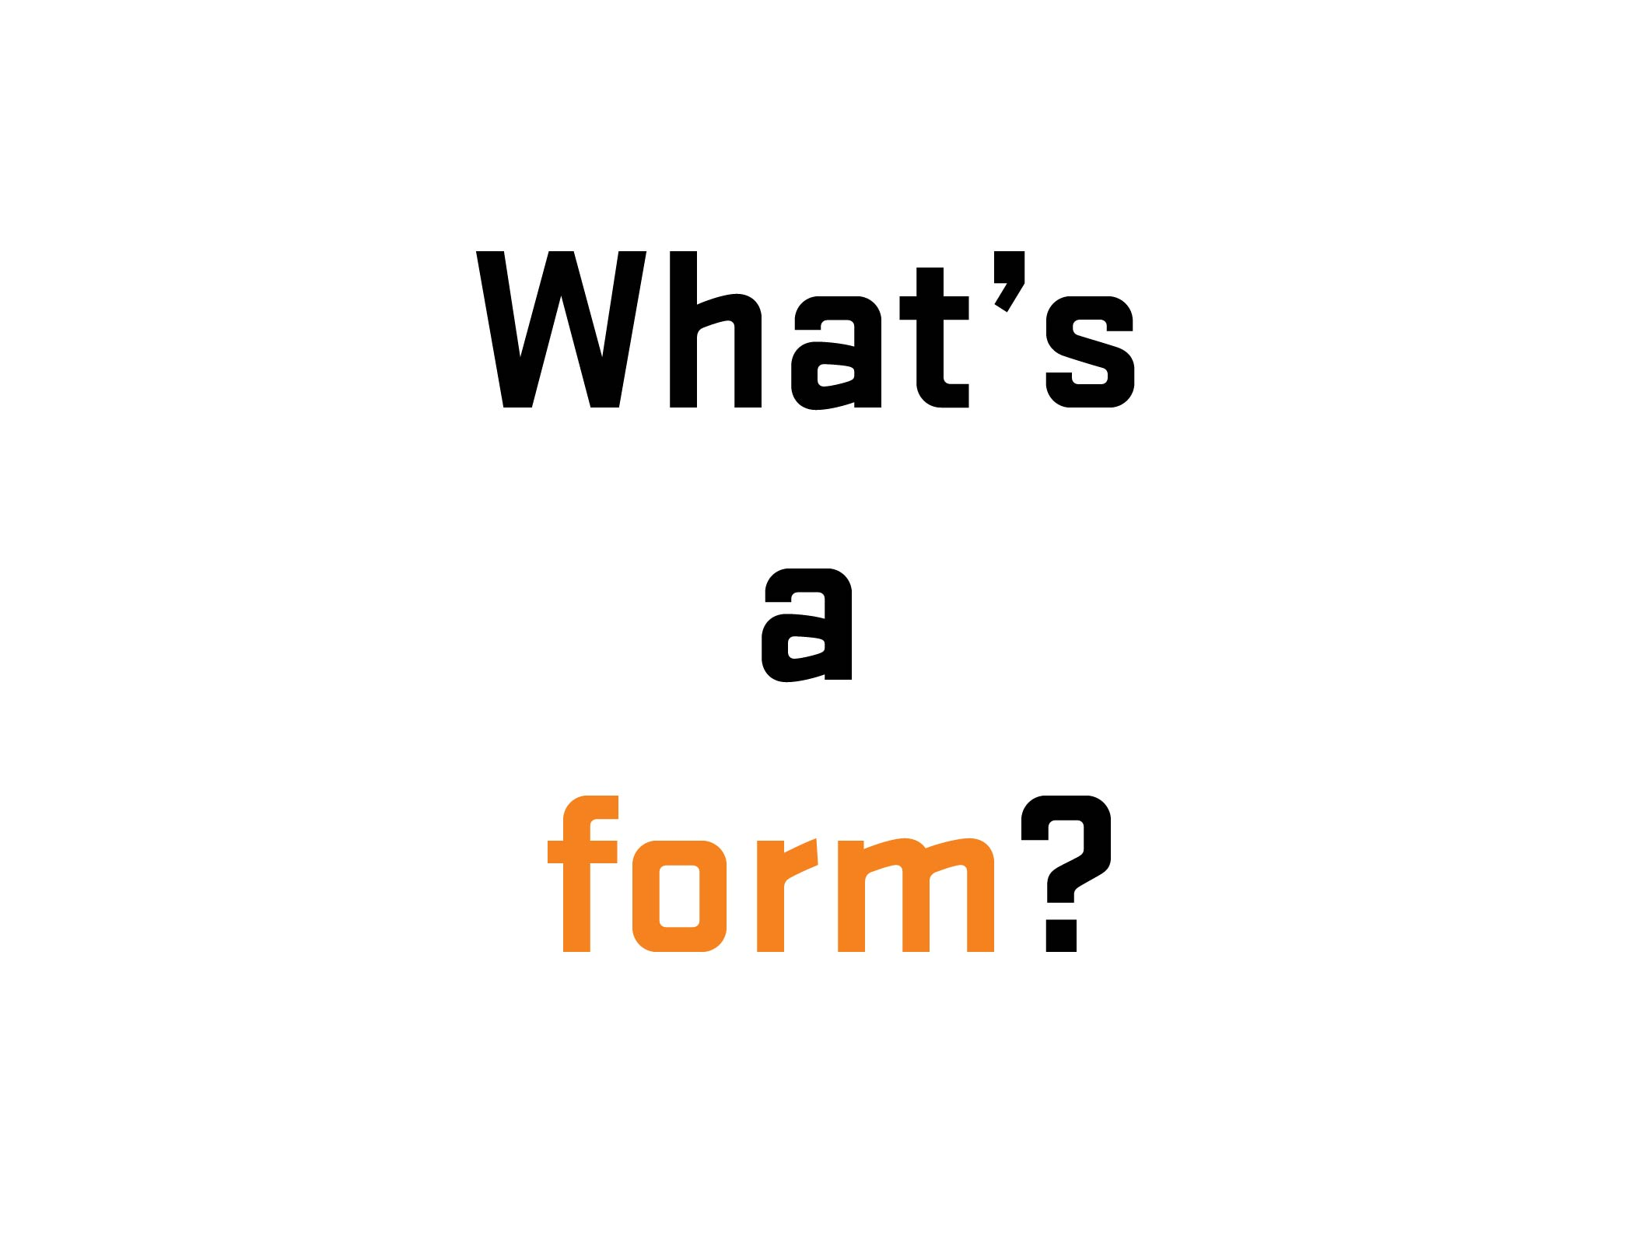
Notes:
17

Slide 18
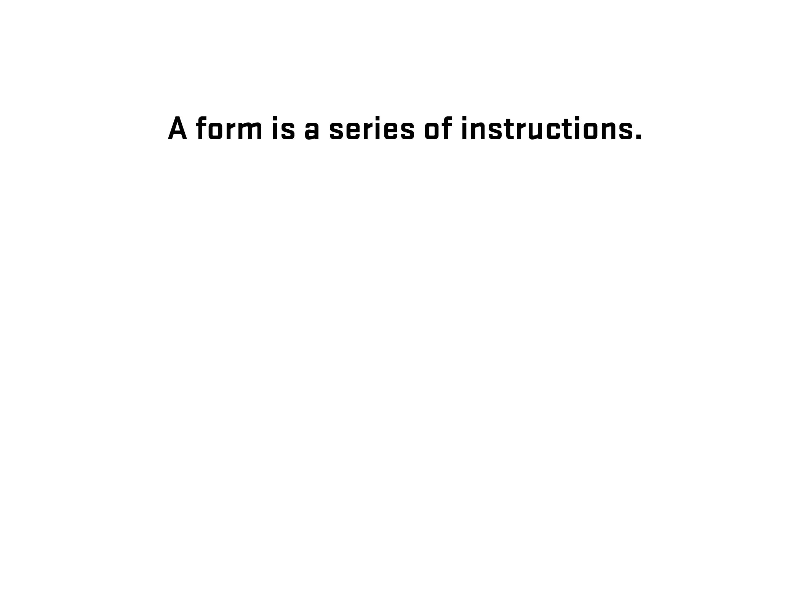
Notes:
18

Slide 19
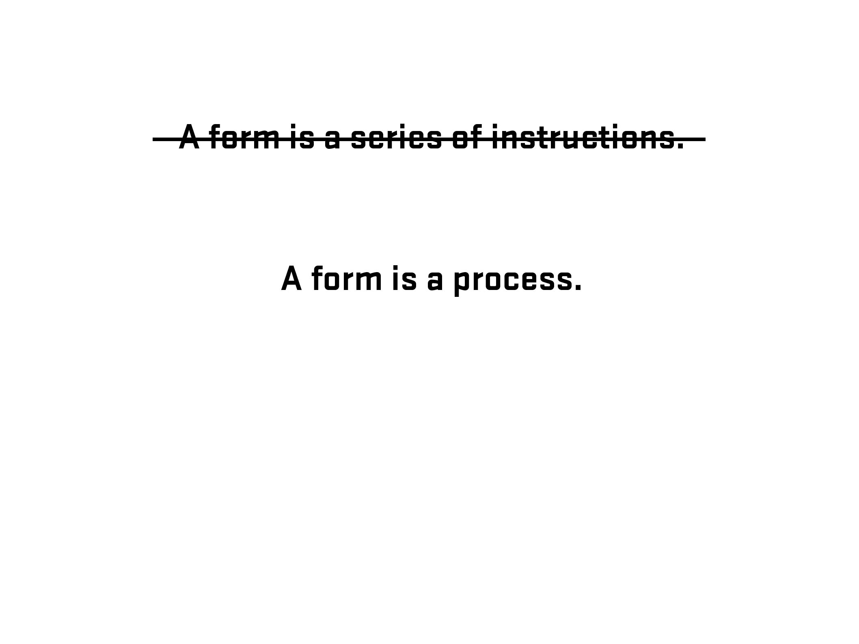
Notes:
19

Slide 20
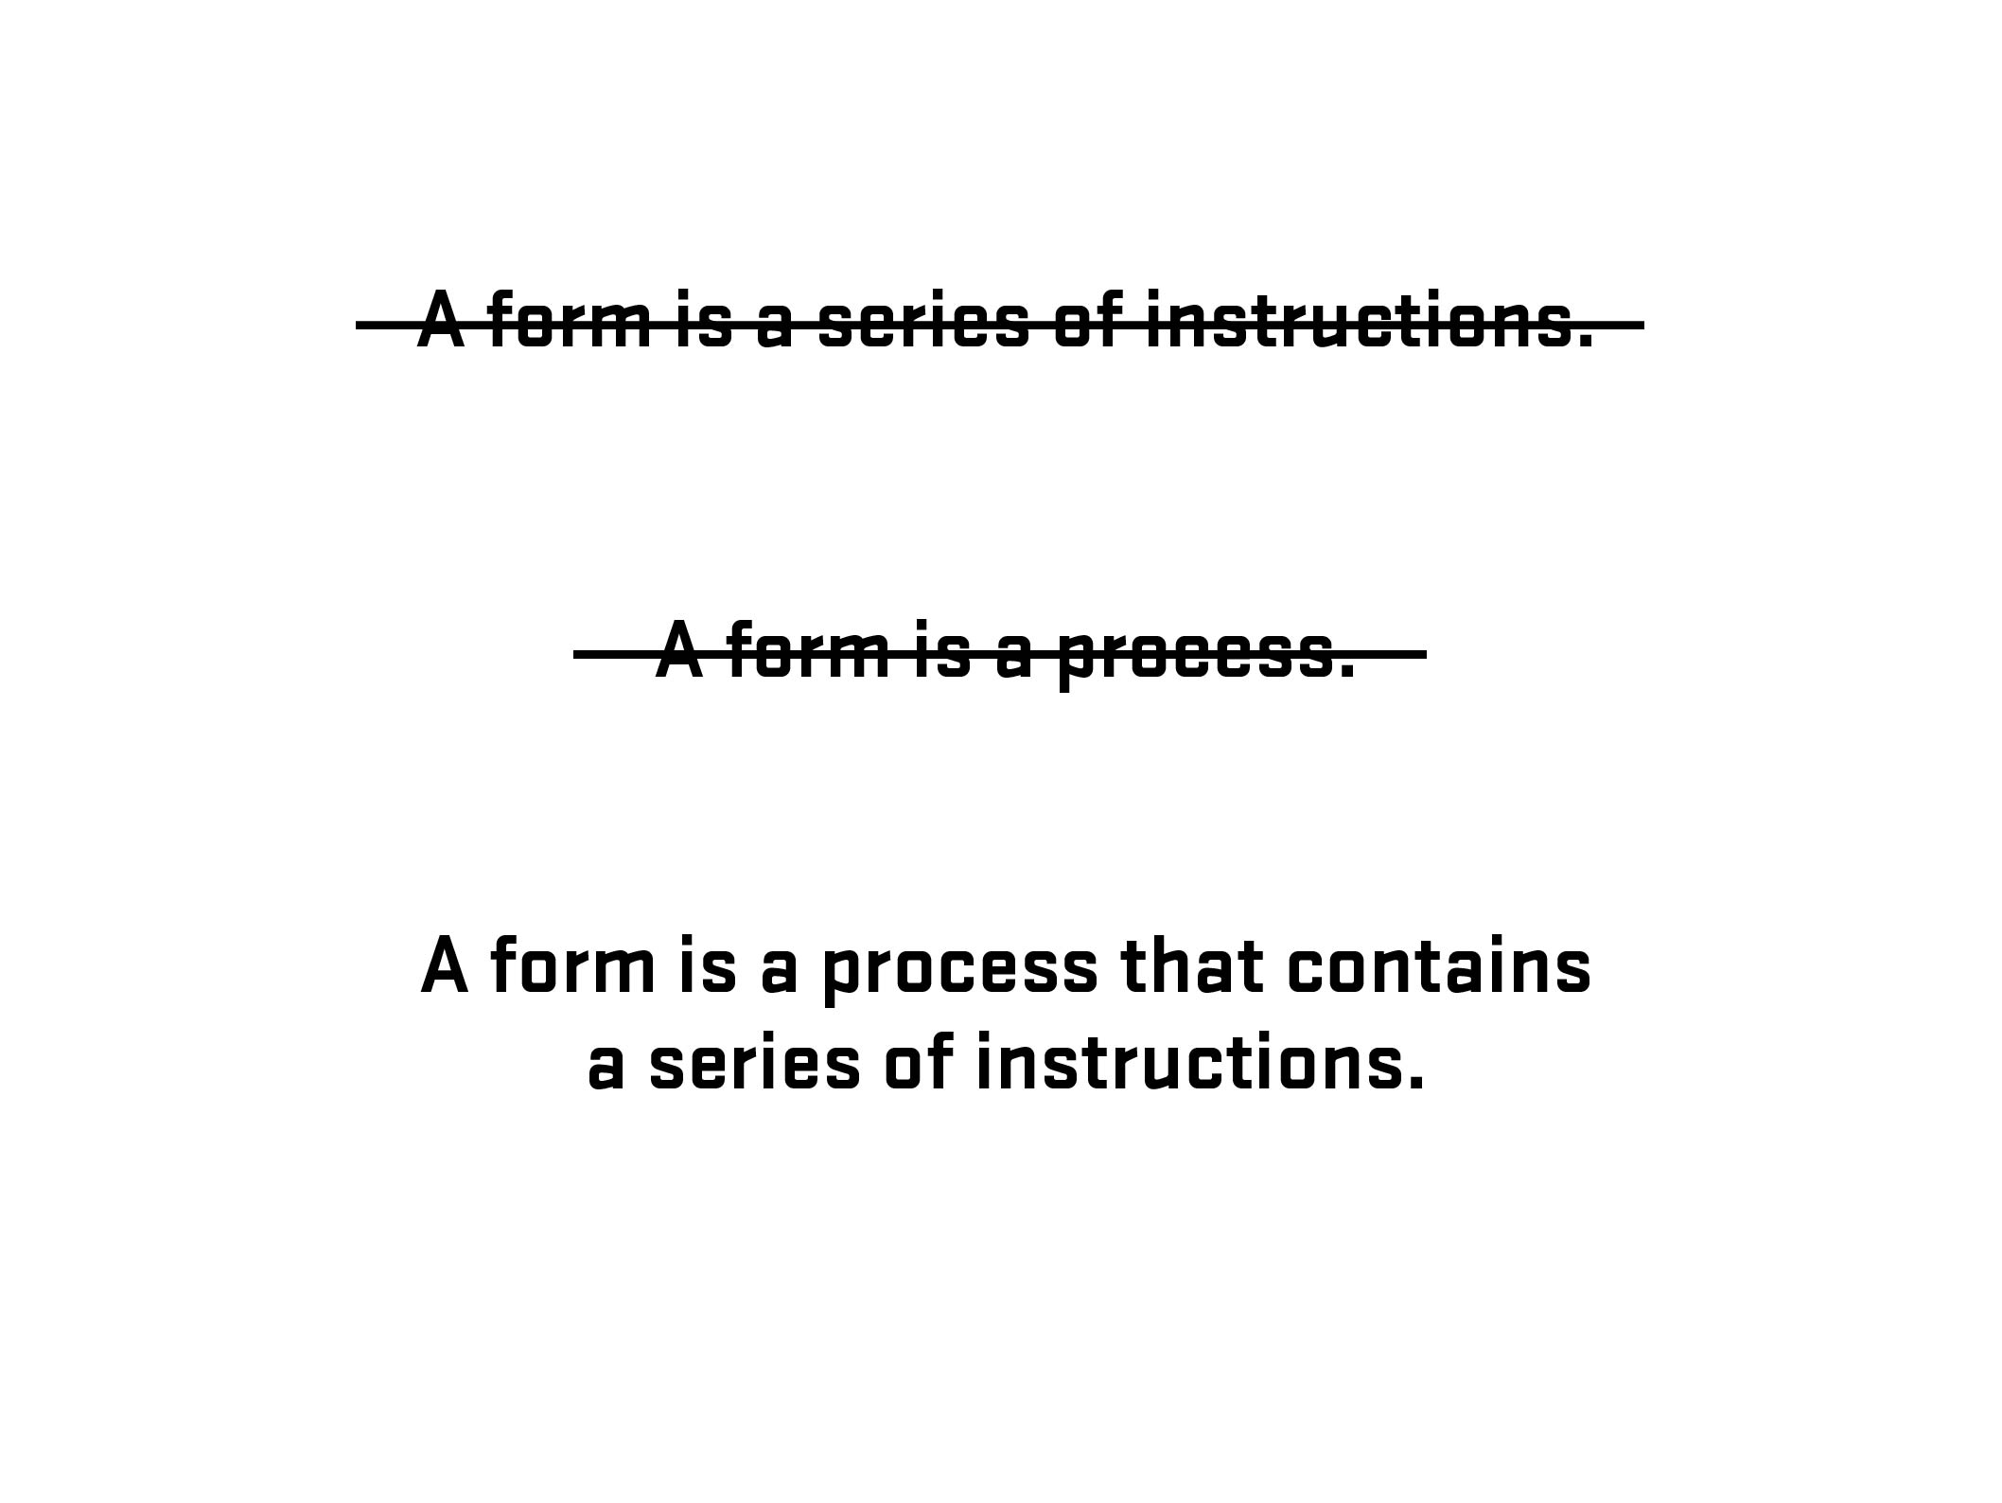
Notes:
20

Slide 21
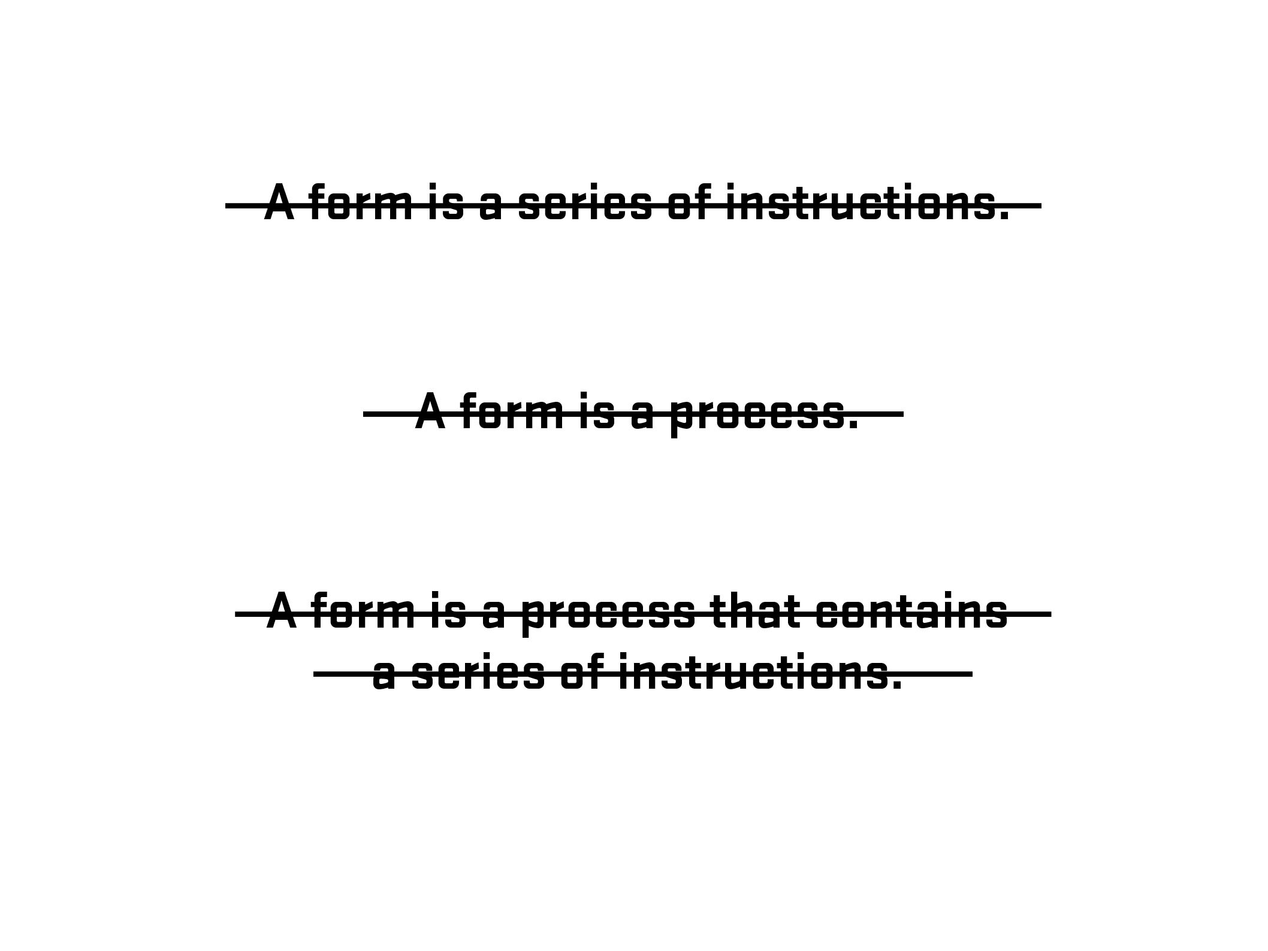
Notes:
21

Slide 22
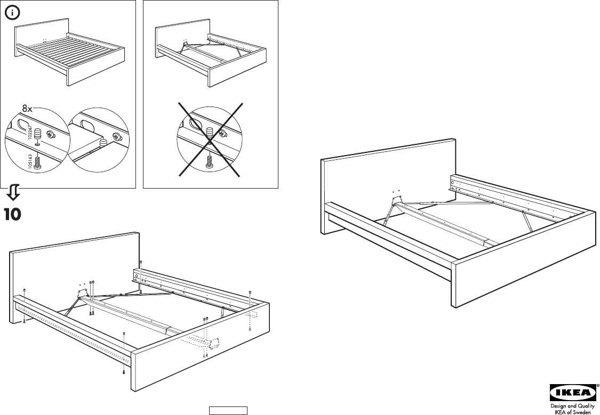
Notes:
22

Slide 23

Photo – Space Lab, Vancouver, Canada (Clint Moroz)
Notes:
23

Slide 24
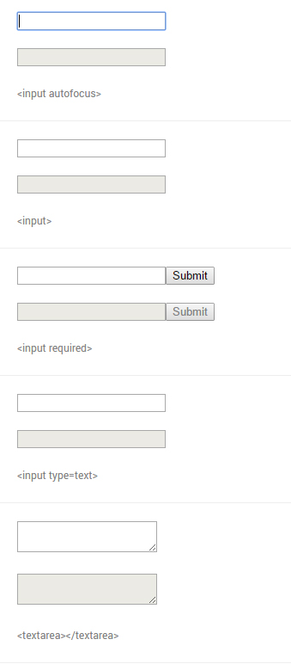
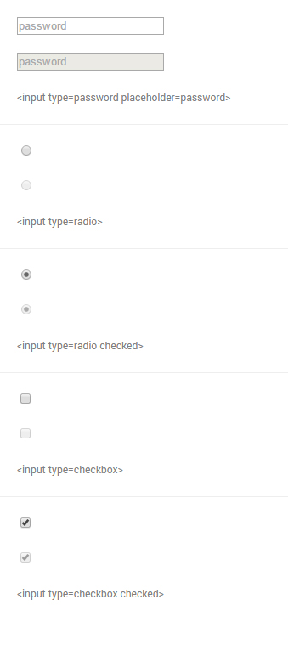
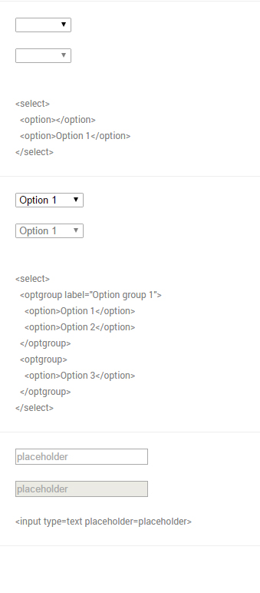
From Native form elements (http://nativeformelements.com/) - Joshua Jenkins
Notes:
24

Slide 25
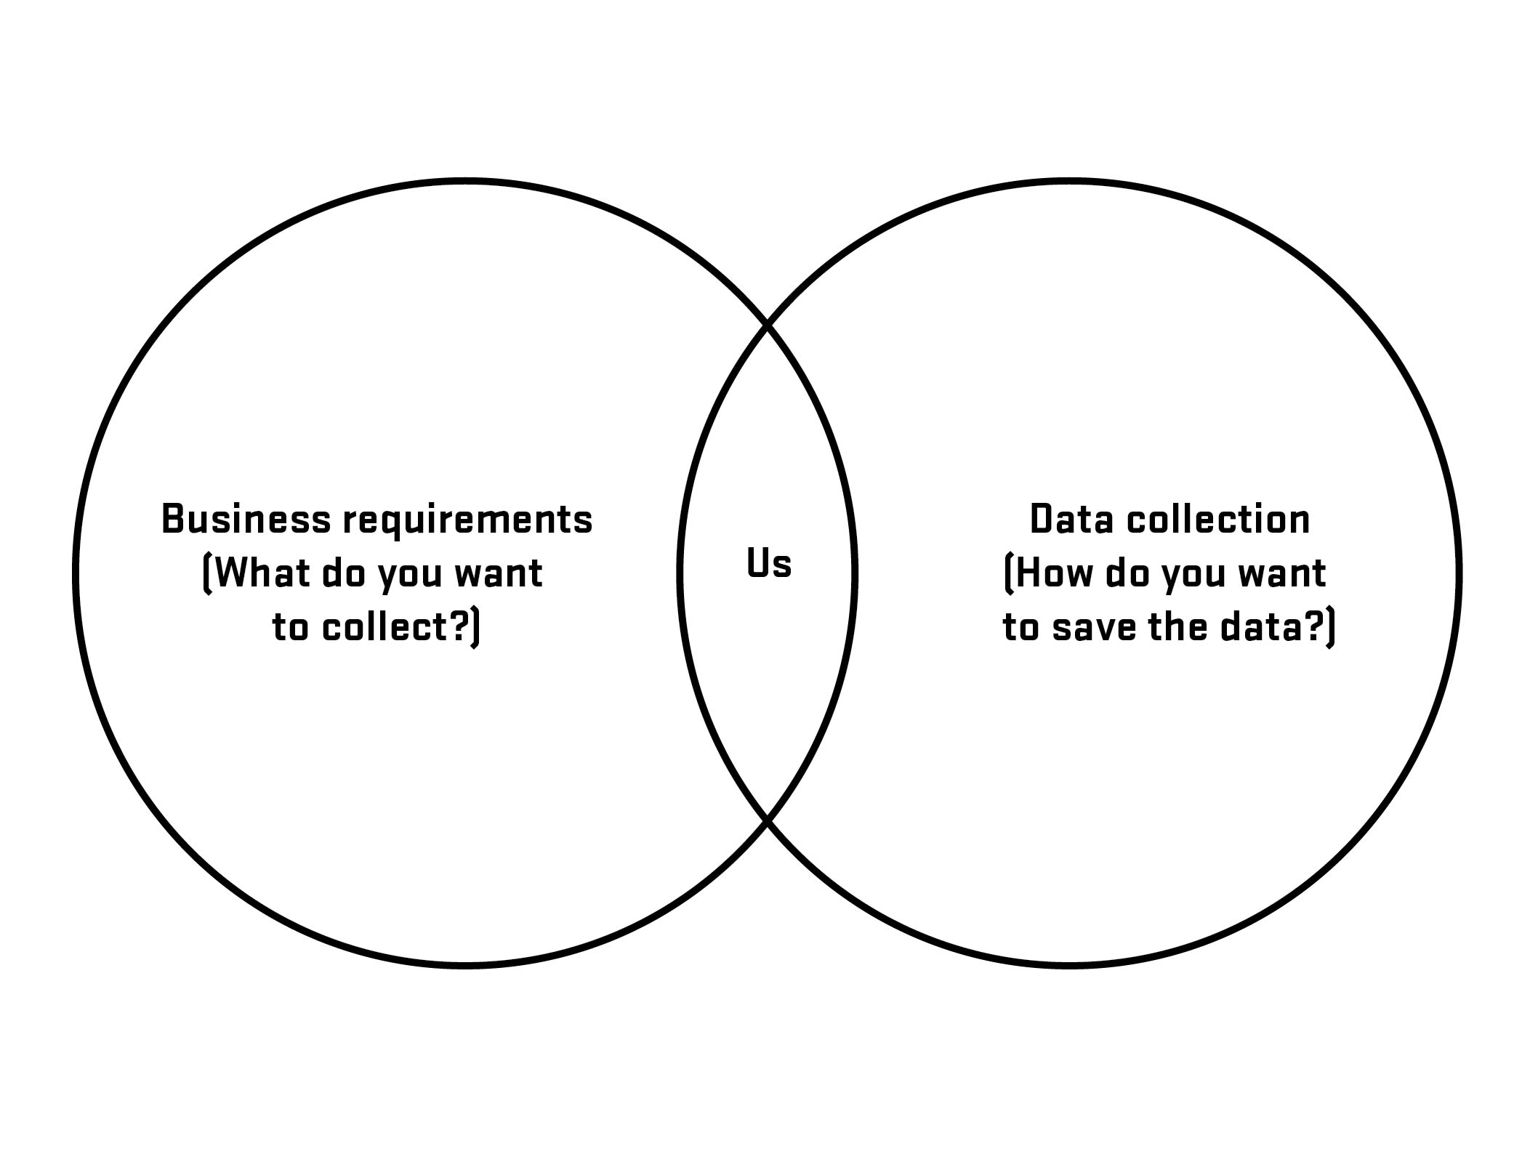

Slide 26
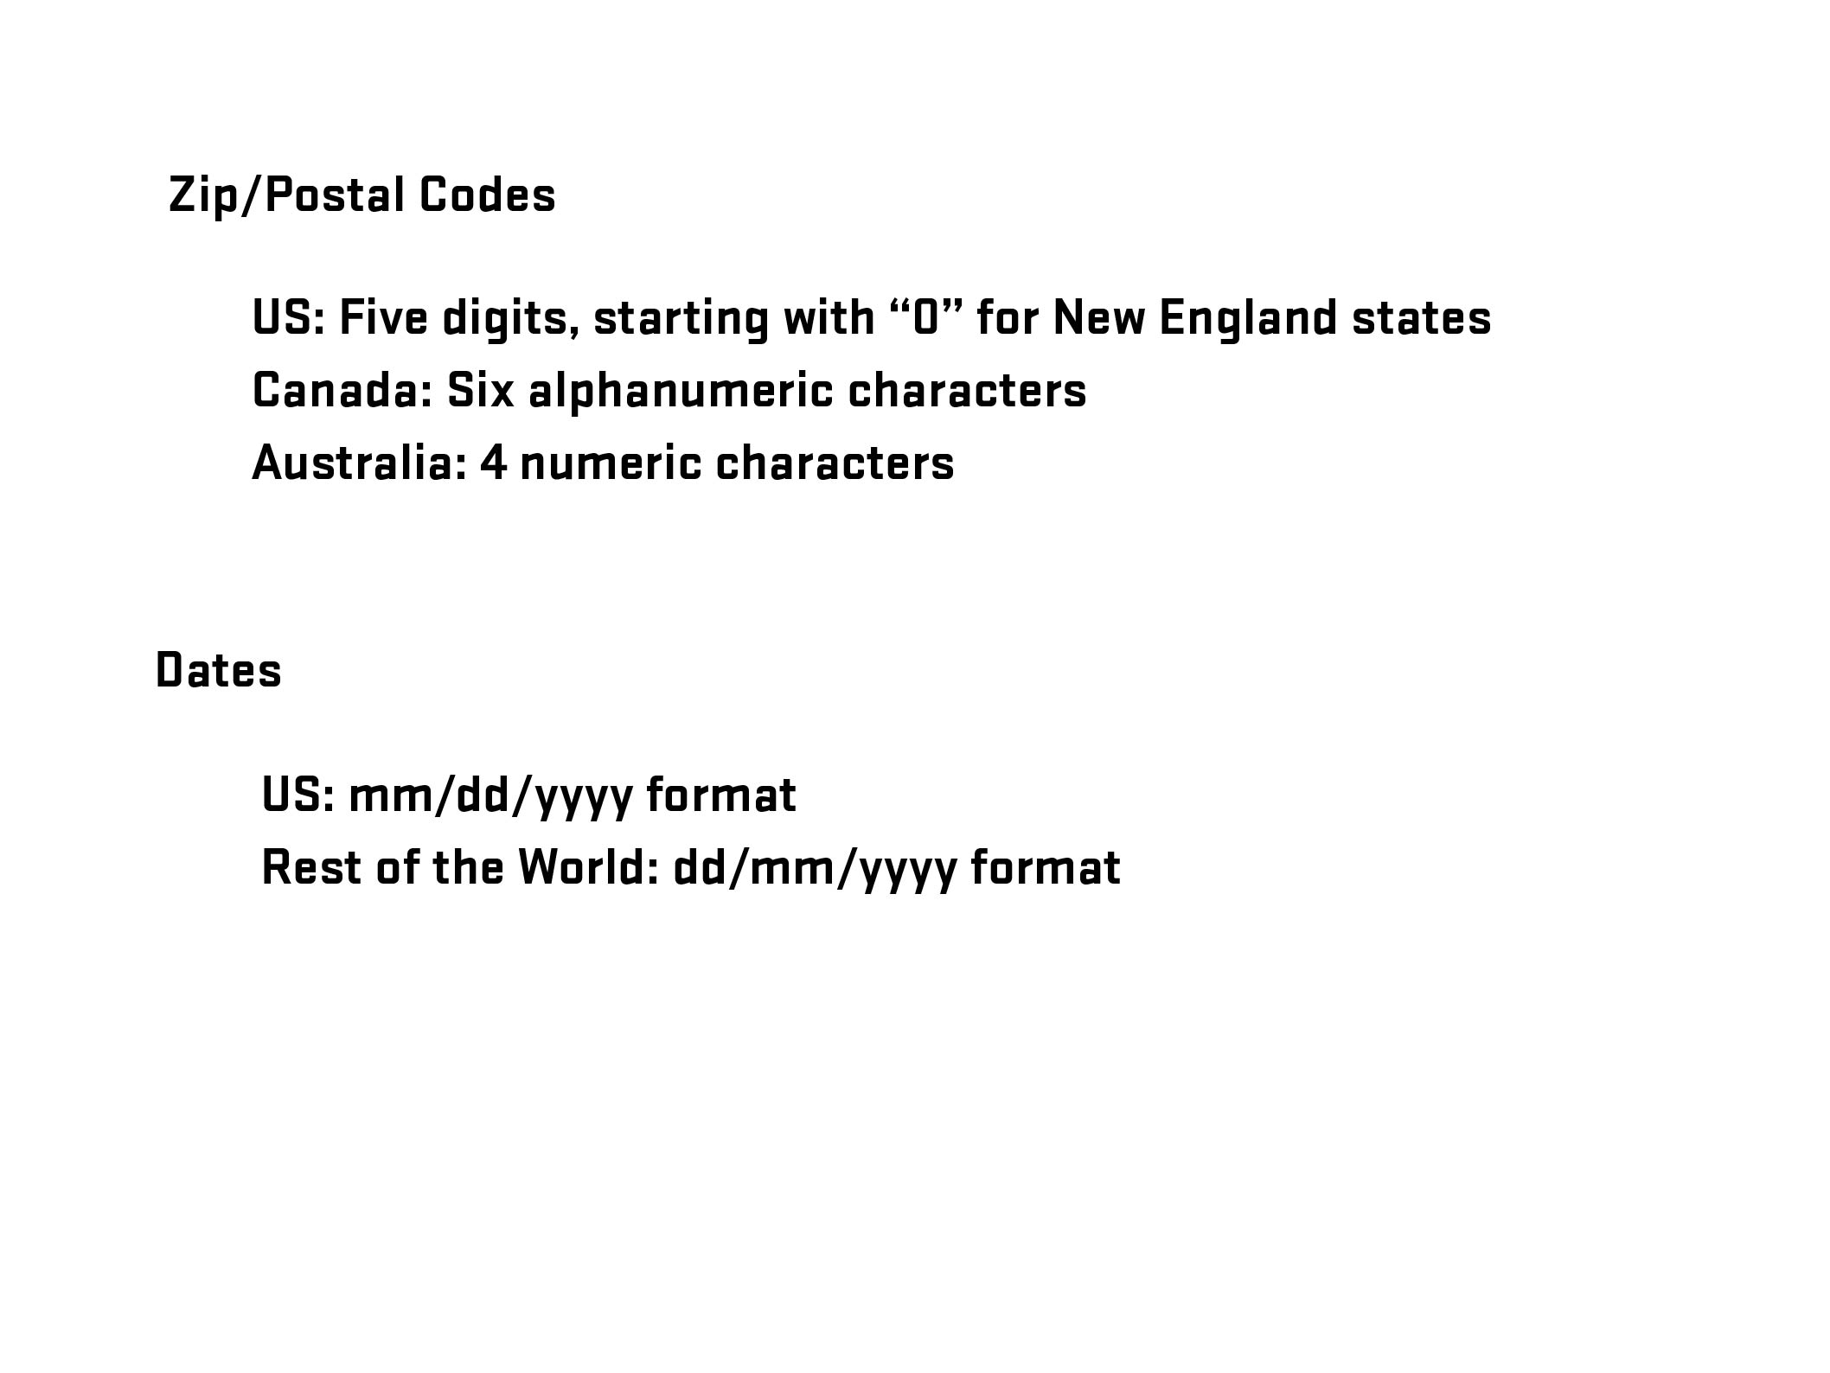

Slide 27
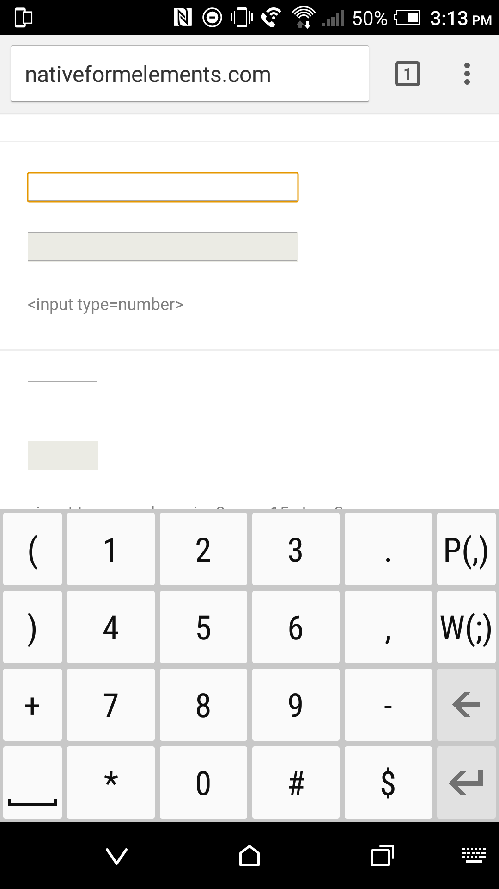
input type=“number”
Notes:
27

Slide 28
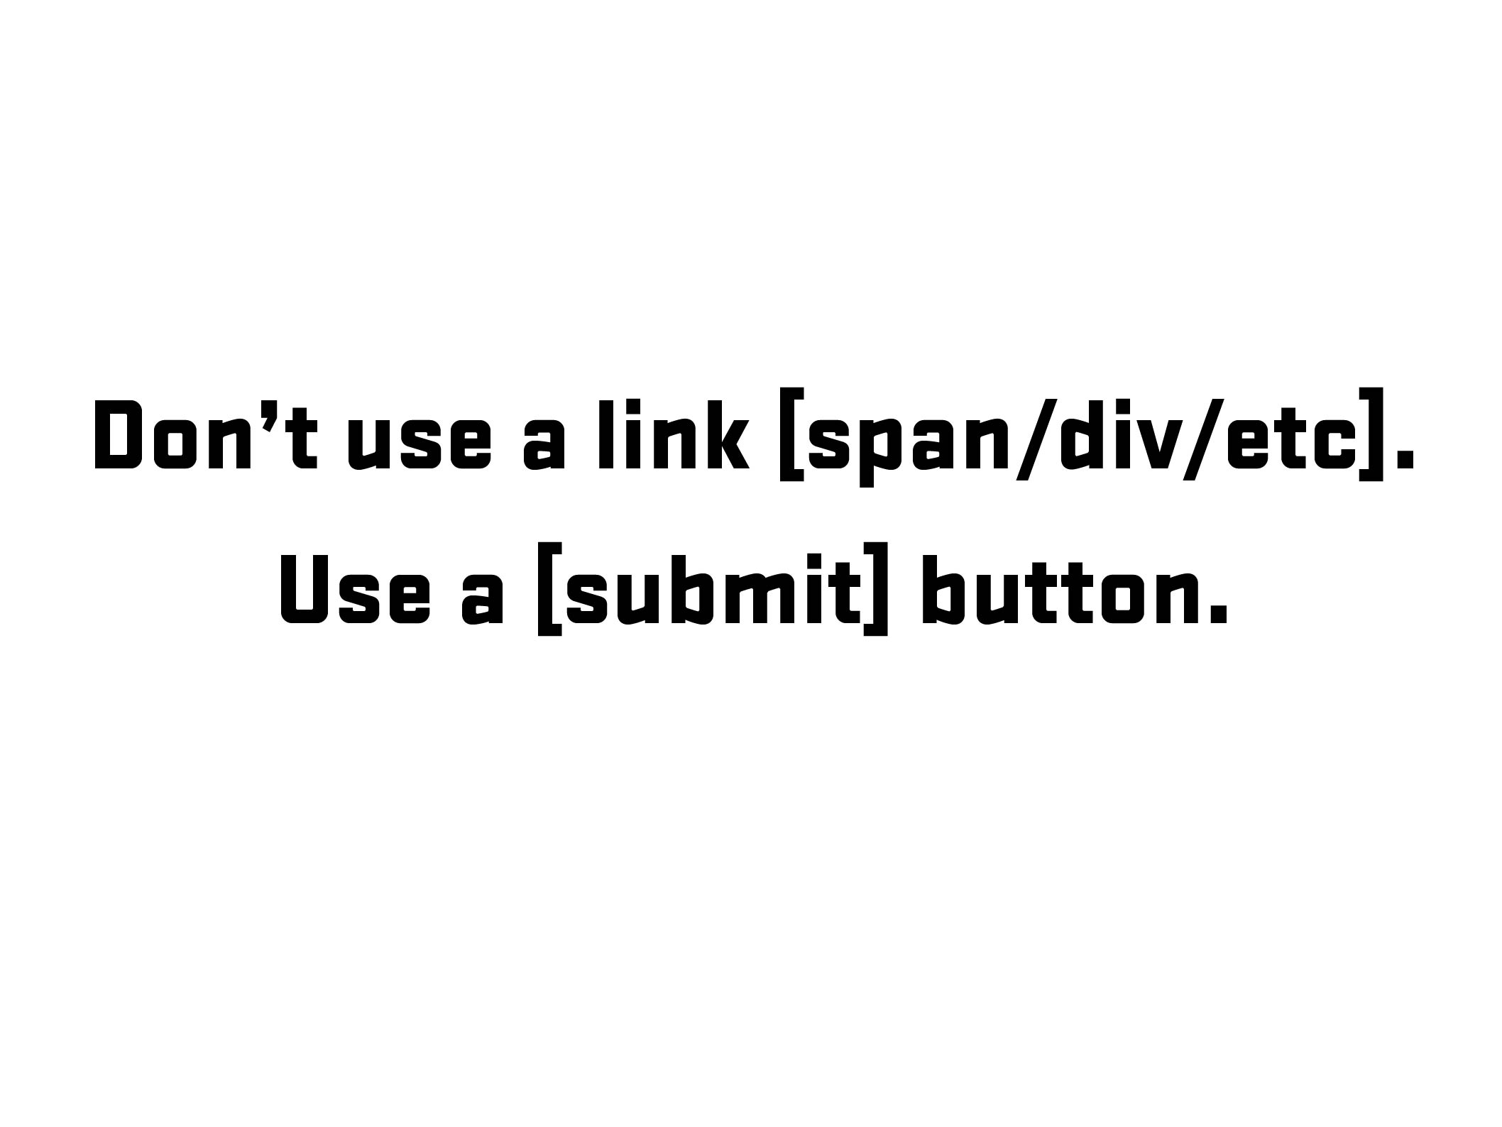

Slide 29
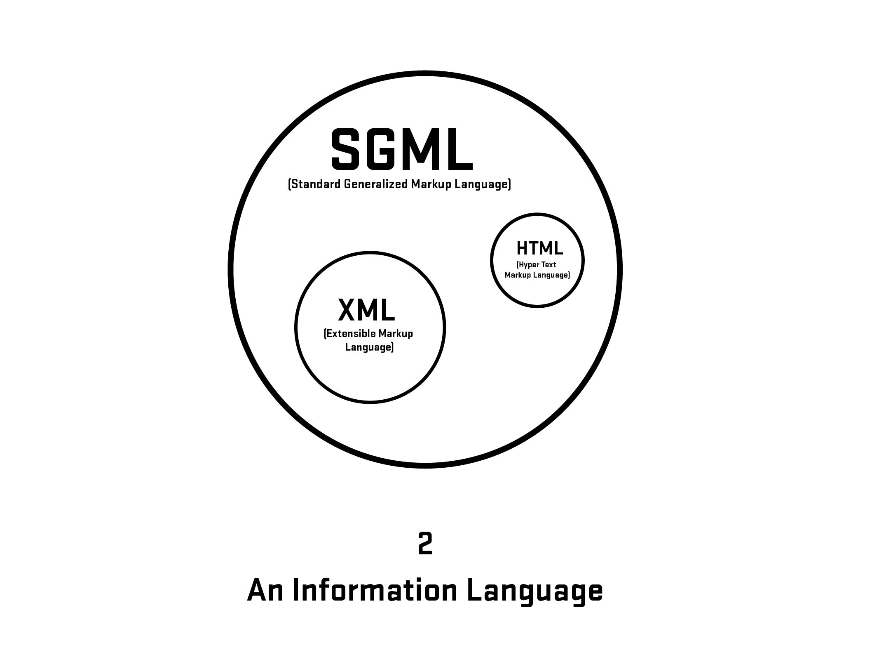
Notes:
29

Slide 30
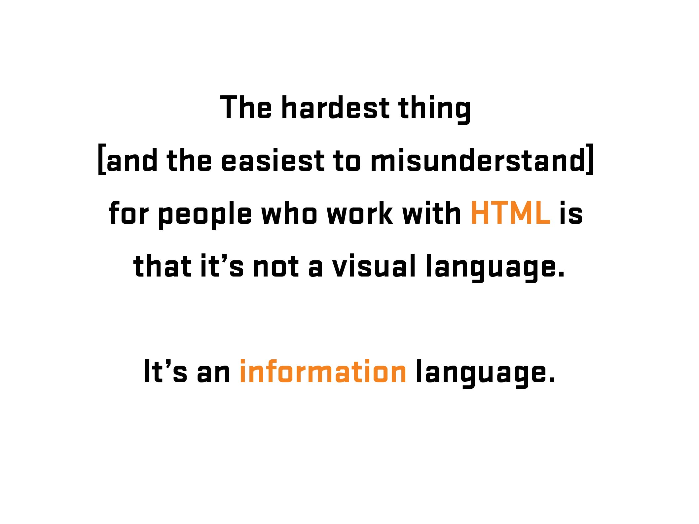
Notes:
30
30

Slide 31

More Information: https://en.wikipedia.org/wiki/Kaieteur_Falls
Notes:
31
Kaiteur Falls, Guyana
31

Slide 32

Notes:
32
Kaiteur Falls, Guyana
32

Slide 33
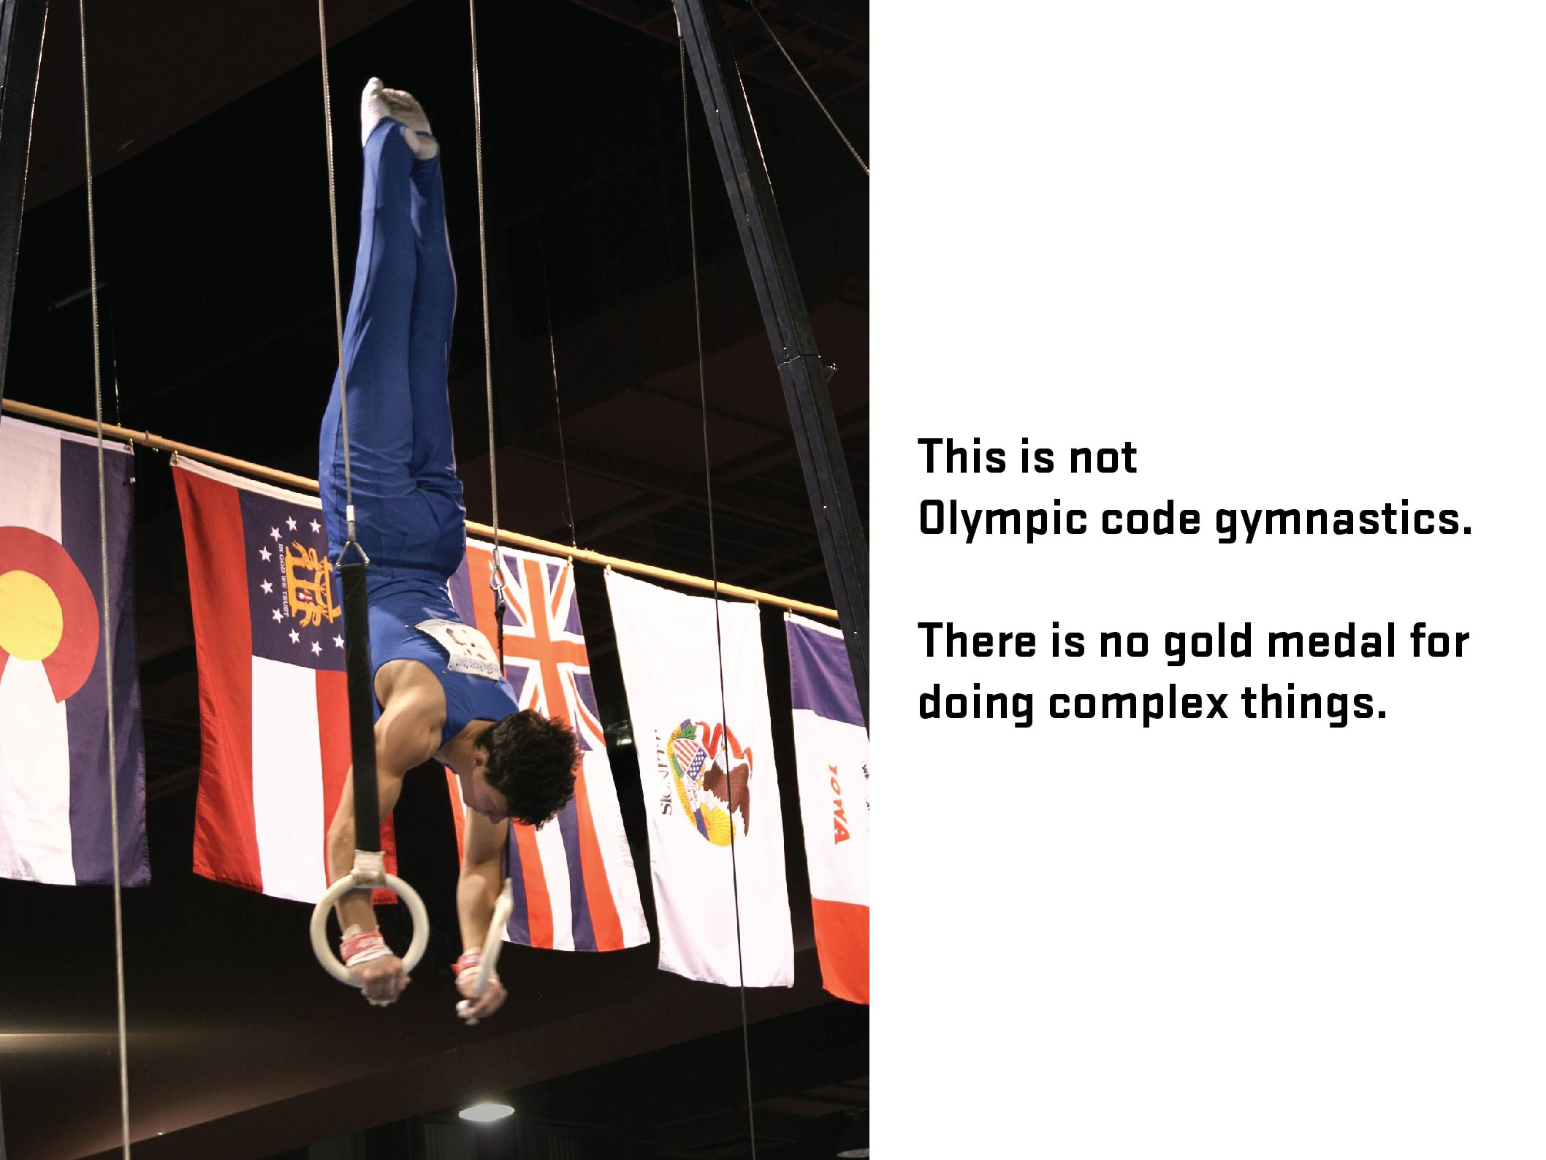

Slide 34
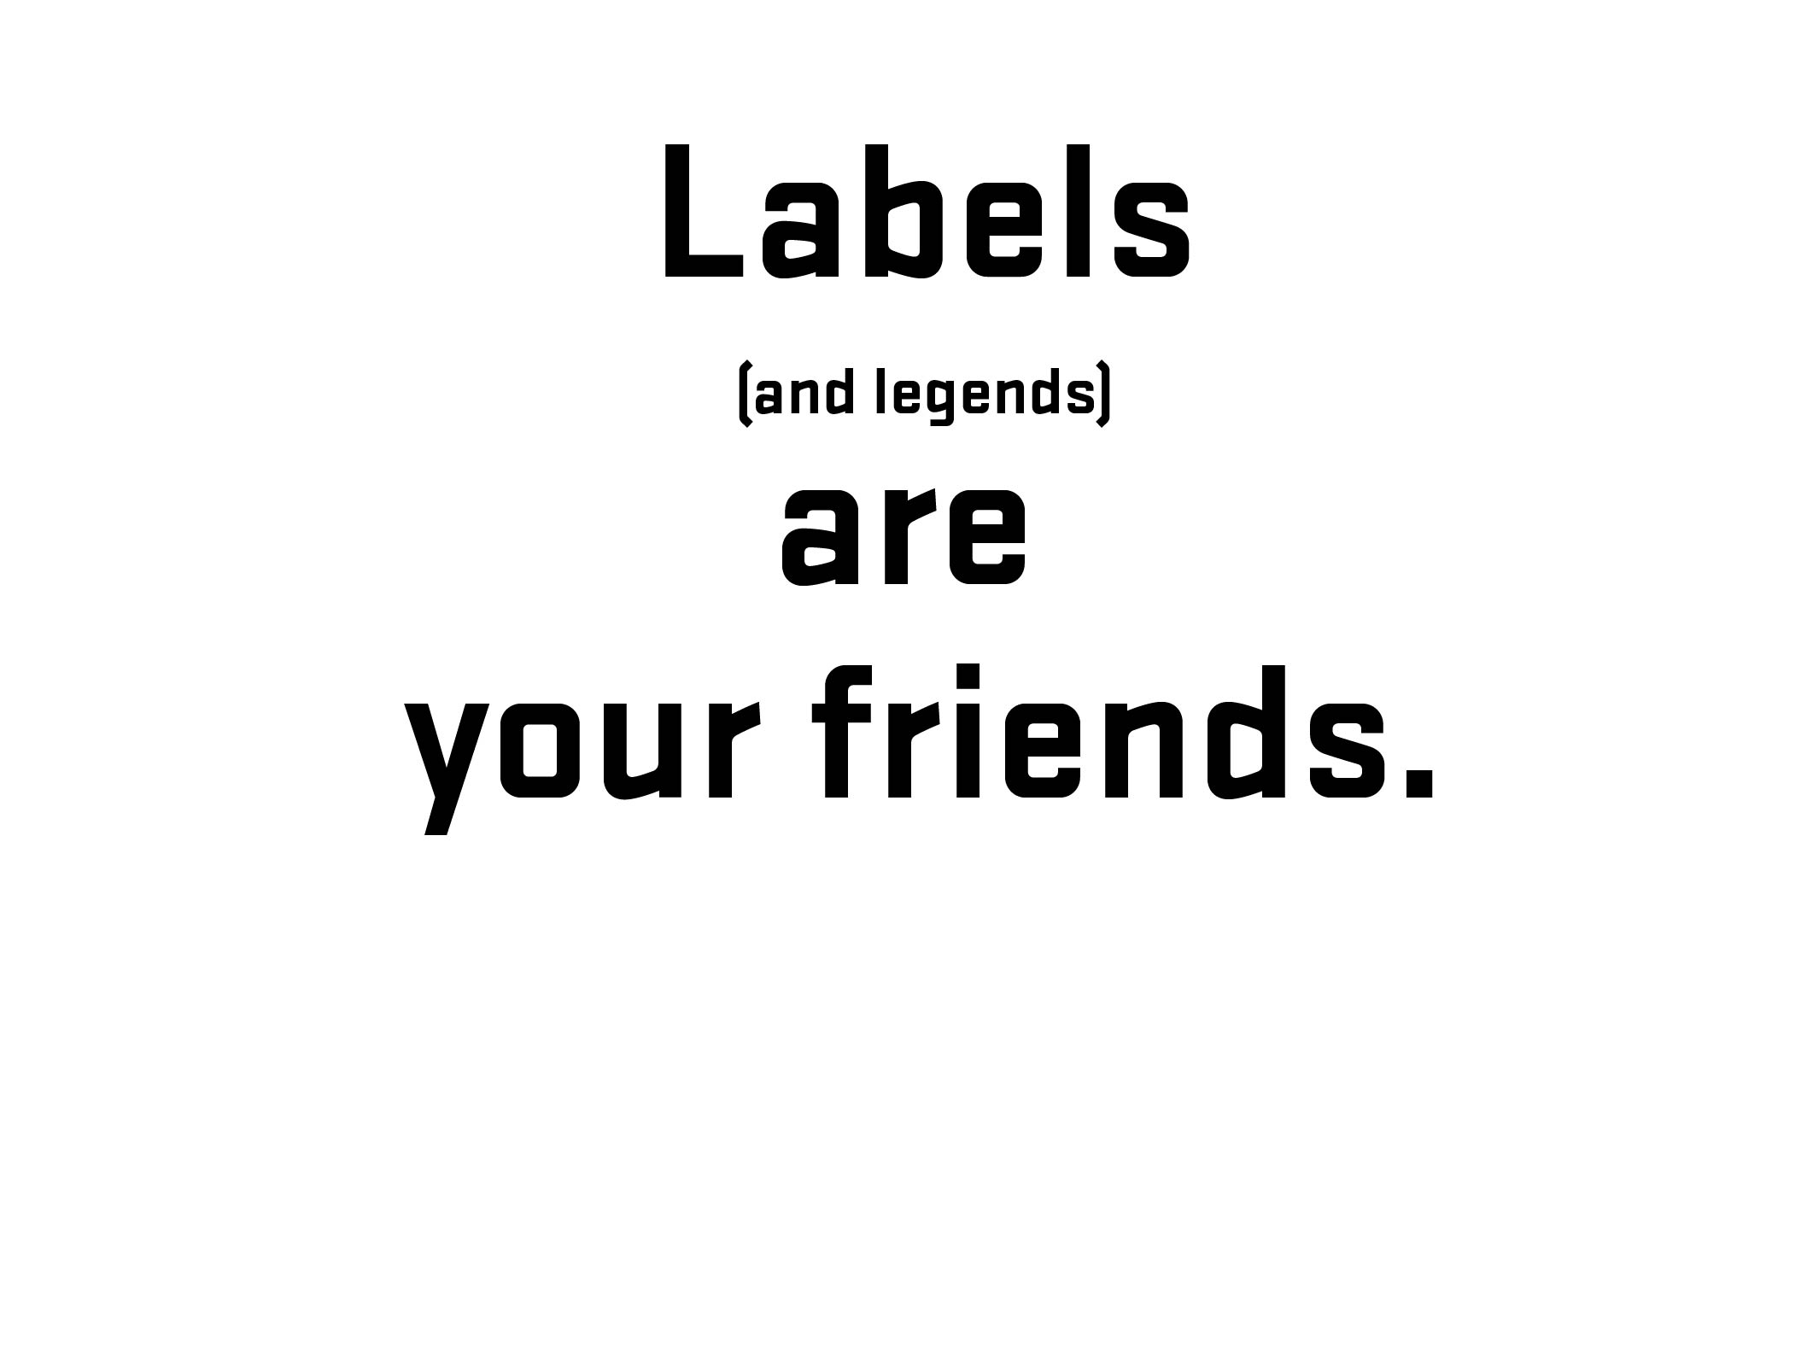

Notes:
34
Before going further – 1) explain what labels are and 2) what is that difference between placeholder and labels (and why that is important)
34

Slide 35
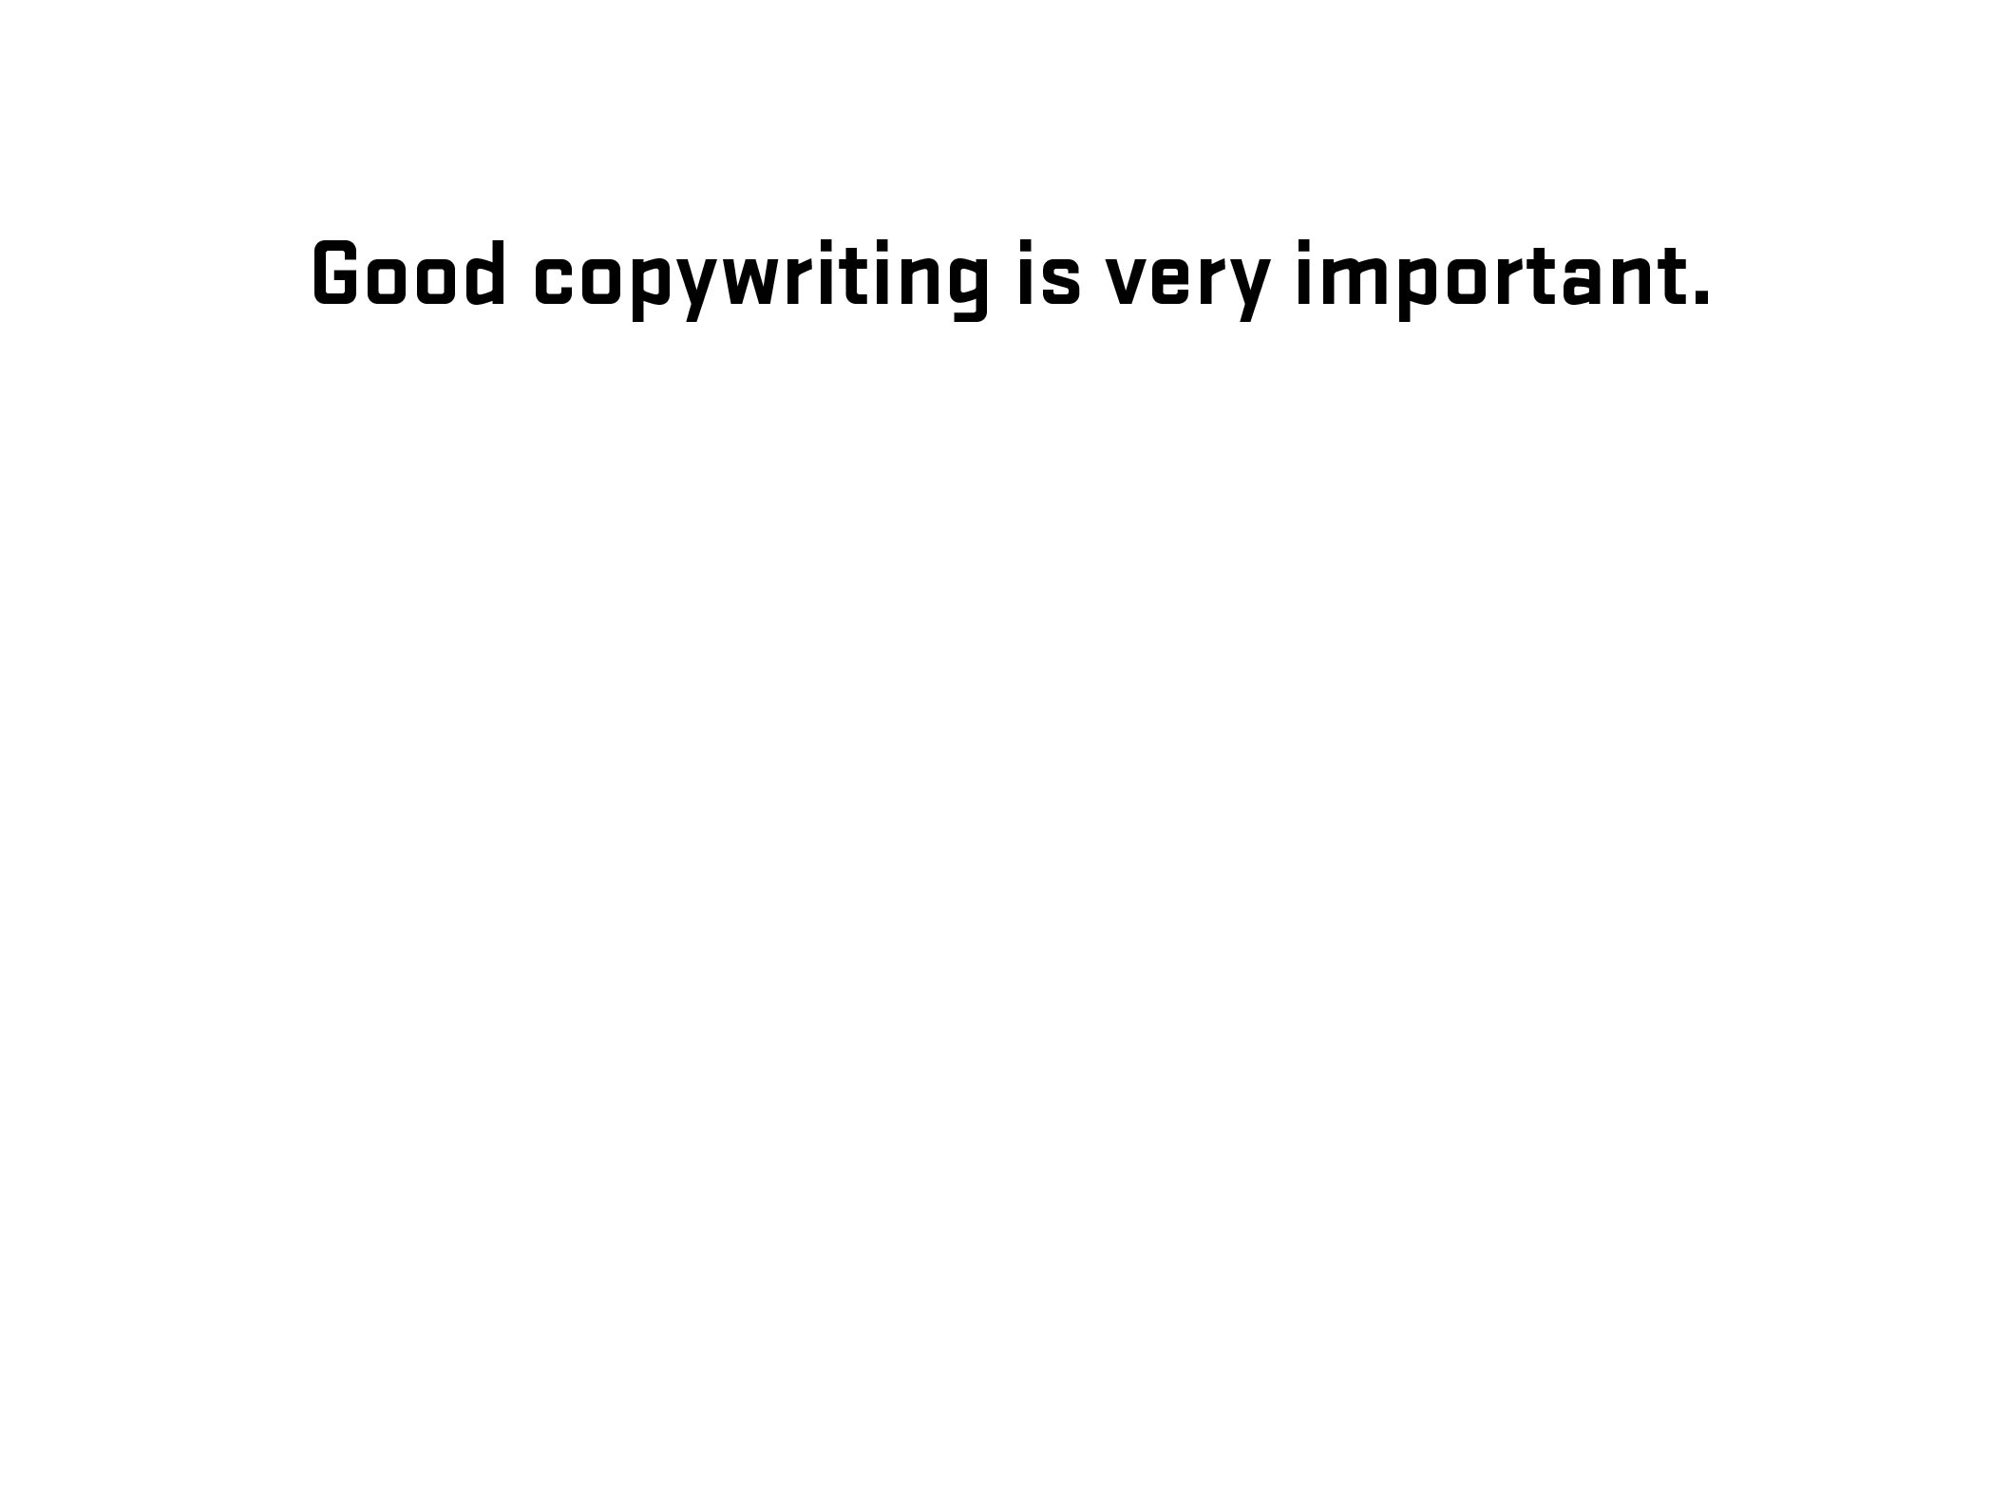
Notes:
35
Diversion – side note about good writing for labels (copywriting)
35

Slide 36
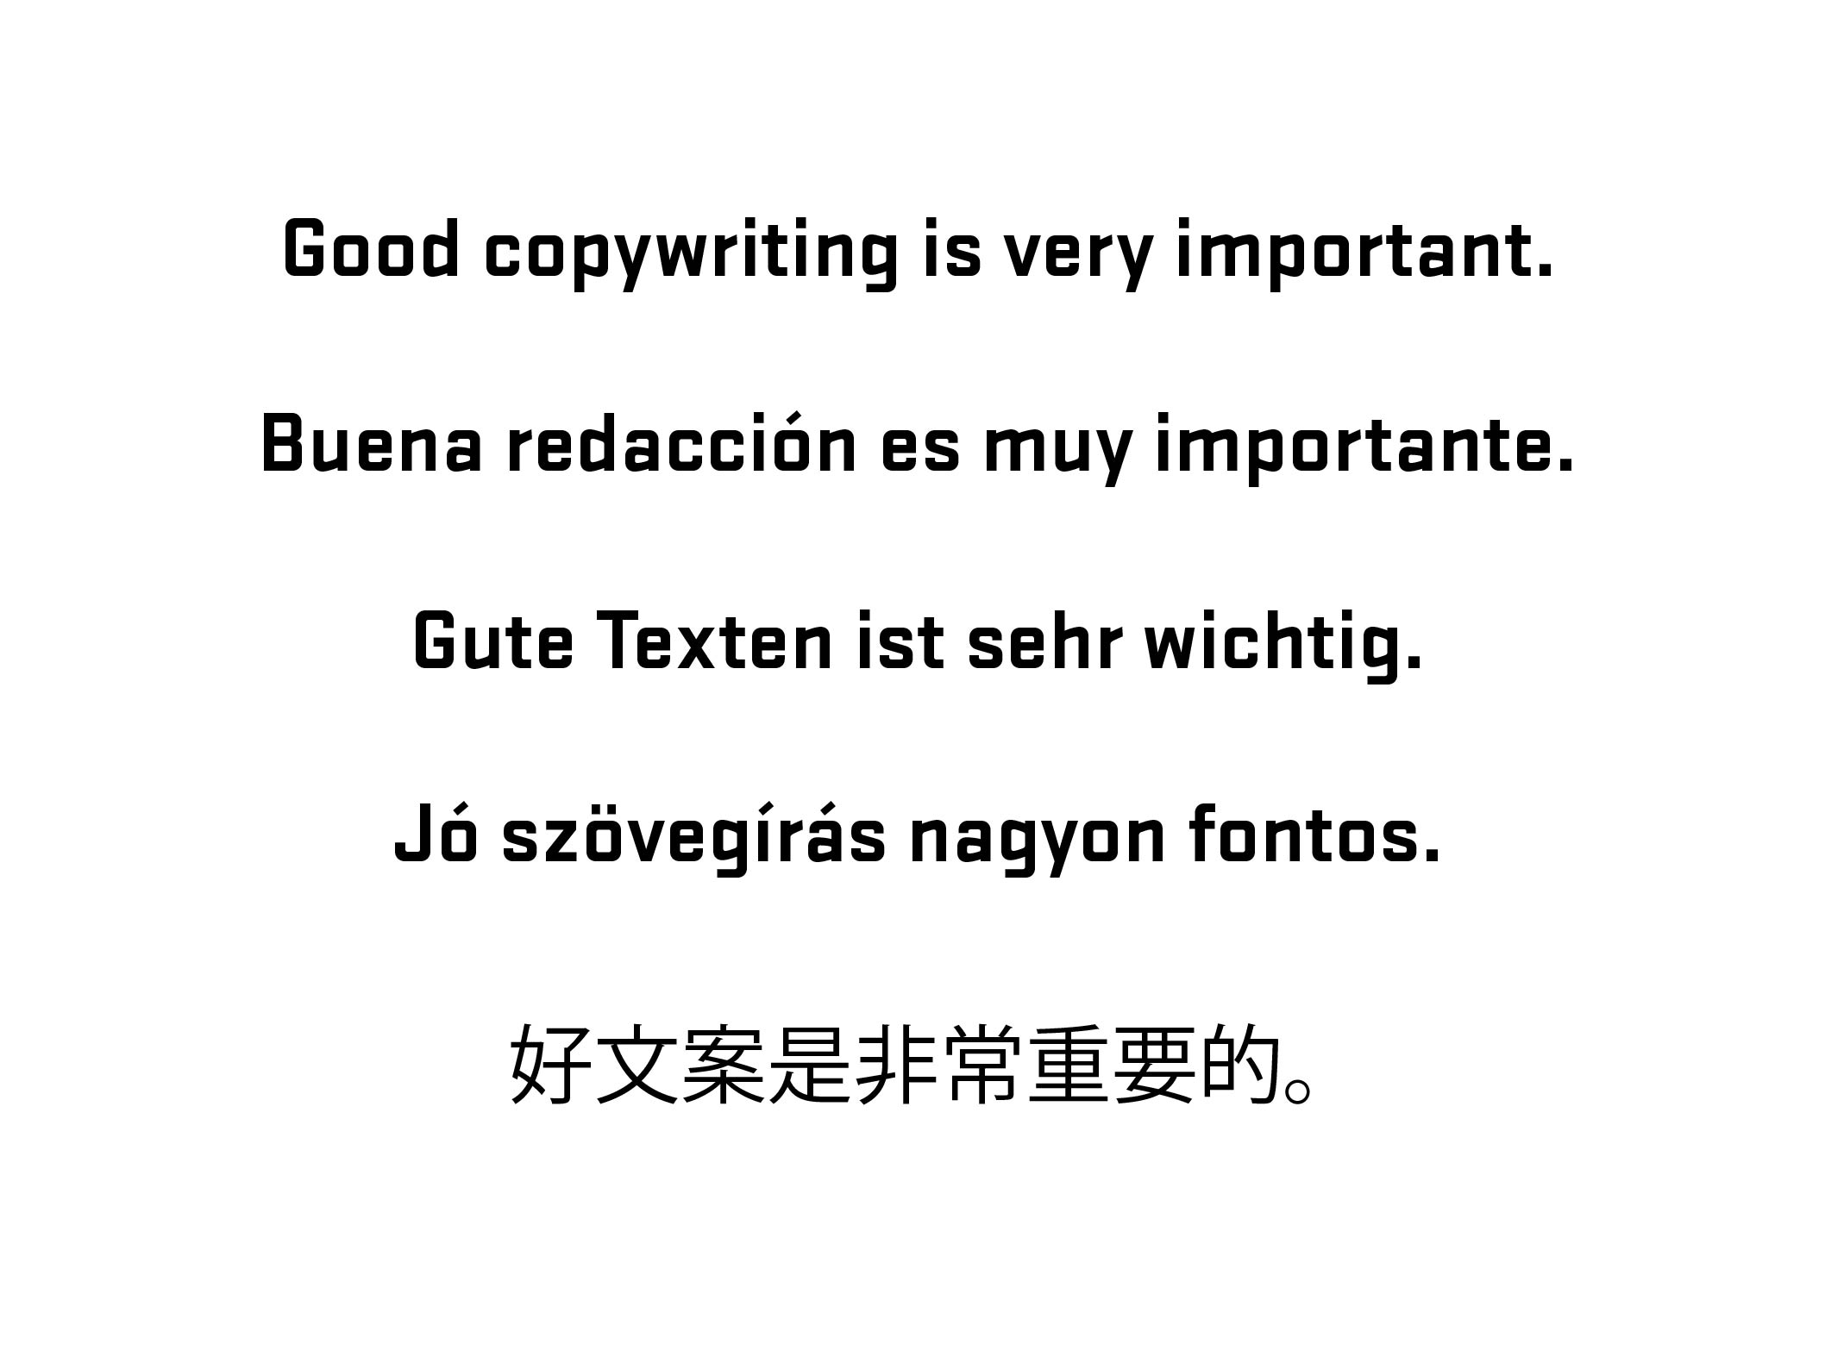
Notes:
36
Diversion – side note about good writing for labels (copywriting)
36

Slide 37
WAI-ARIA
WAI-ARIA (Web Accessibility Initiative – Accessible Rich Internet Applications) is a technical specification published by the World Wide Web Consortium (W3C) that specifies how to increase the accessibility of web pages, in particular, dynamic content and user interface components developed with Ajax, HTML, JavaScript and related technologies.
- Wikipedia (https://en.wikipedia.org/wiki/WAI-ARIA)
Notes:
37
Brief overview of history/explanation. Go further if needed – refer to W3C.
Need list of resources for audience
37

Slide 38
aria-live = [off, polite, assertive, rude]
aria-describedby = [element id]
aria-labelledby = [element id]
Notes:
38

Slide 39
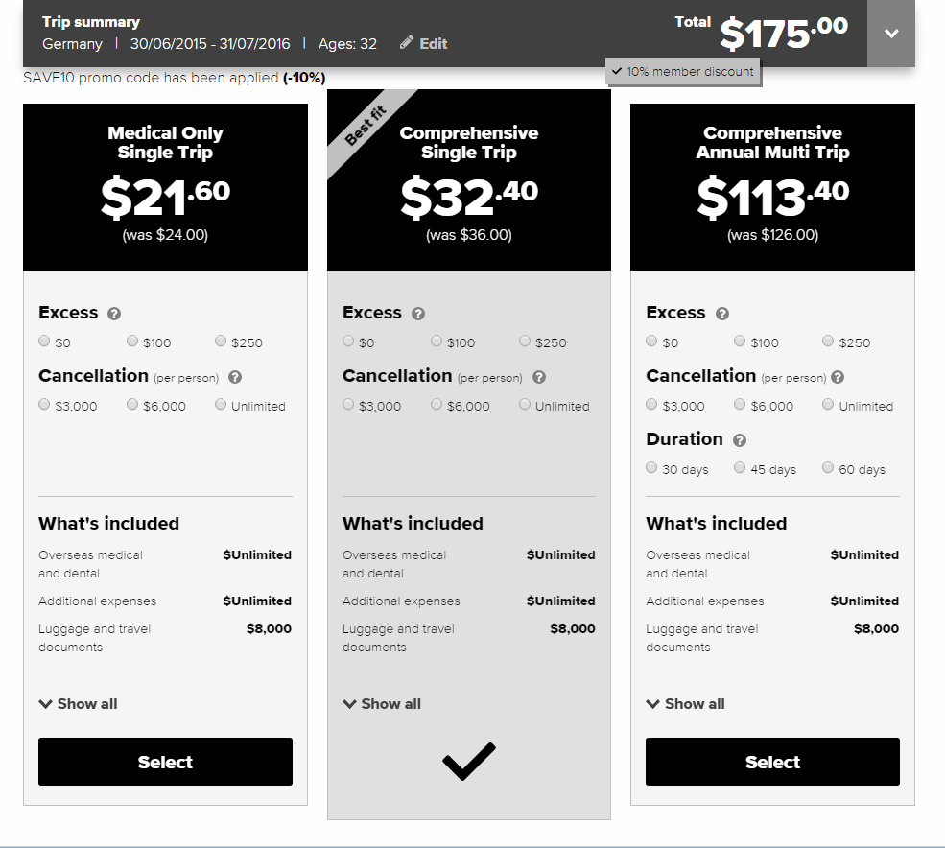
Notes:
39

Slide 40
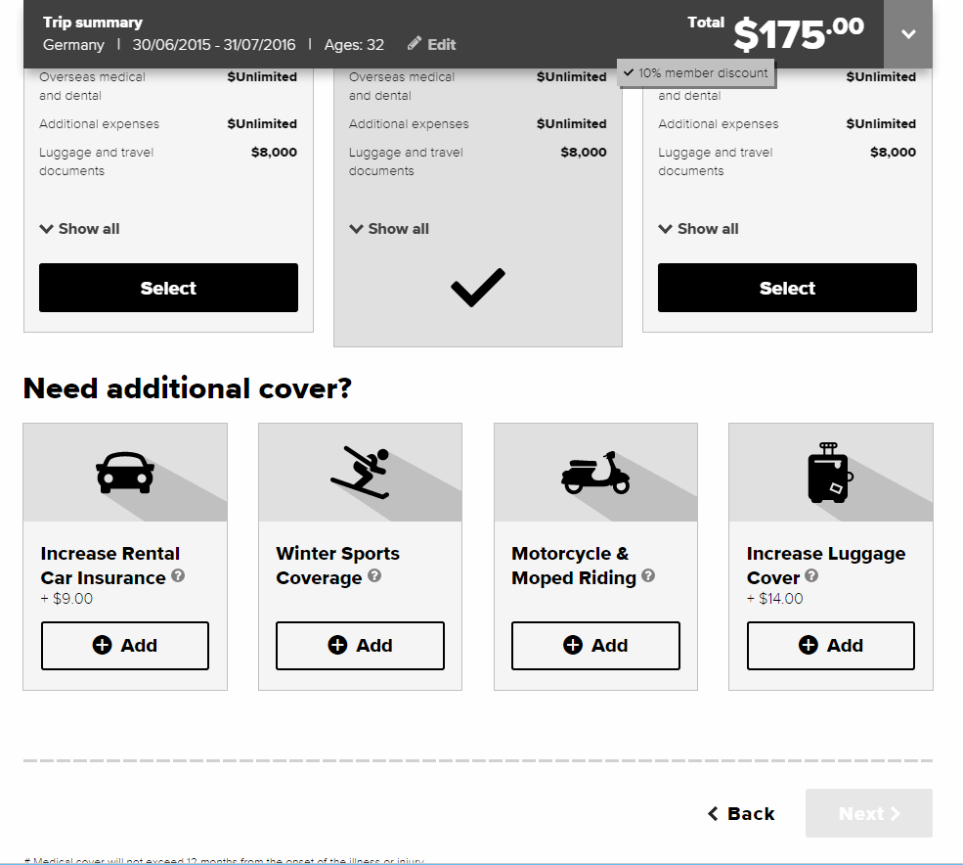
Notes:
40

Slide 41
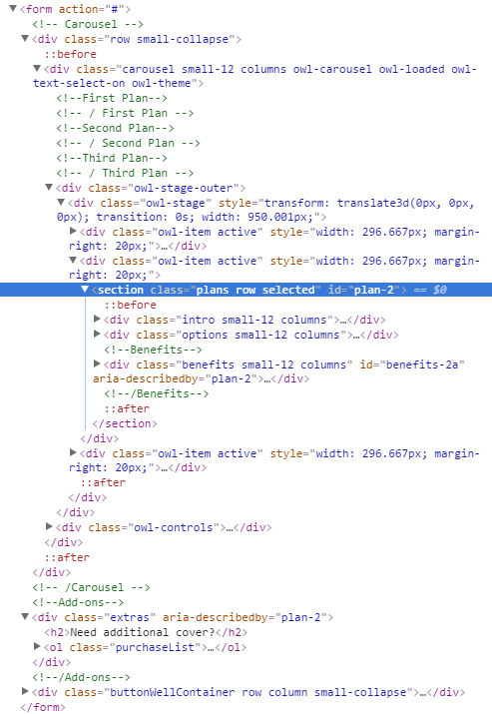
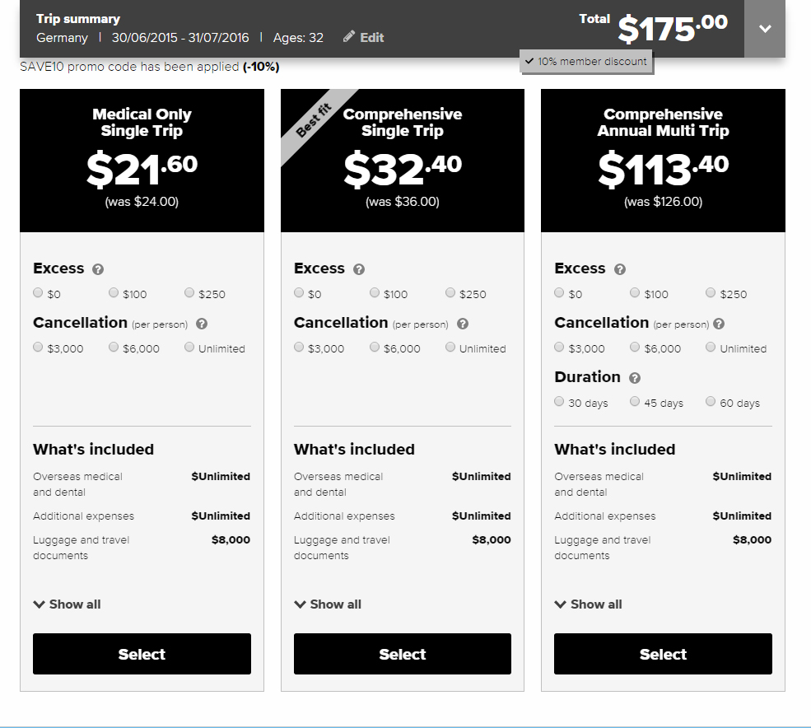
Notes:
41

Slide 42
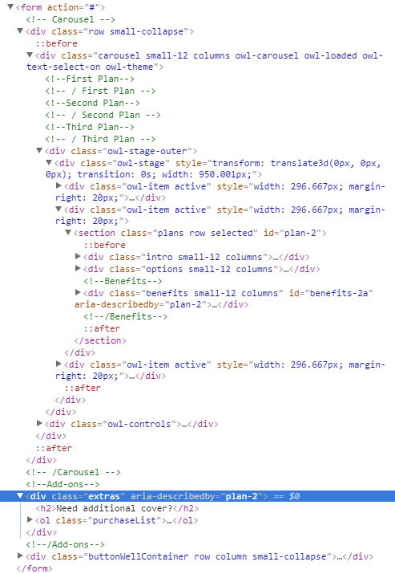
Notes:
42

Slide 43
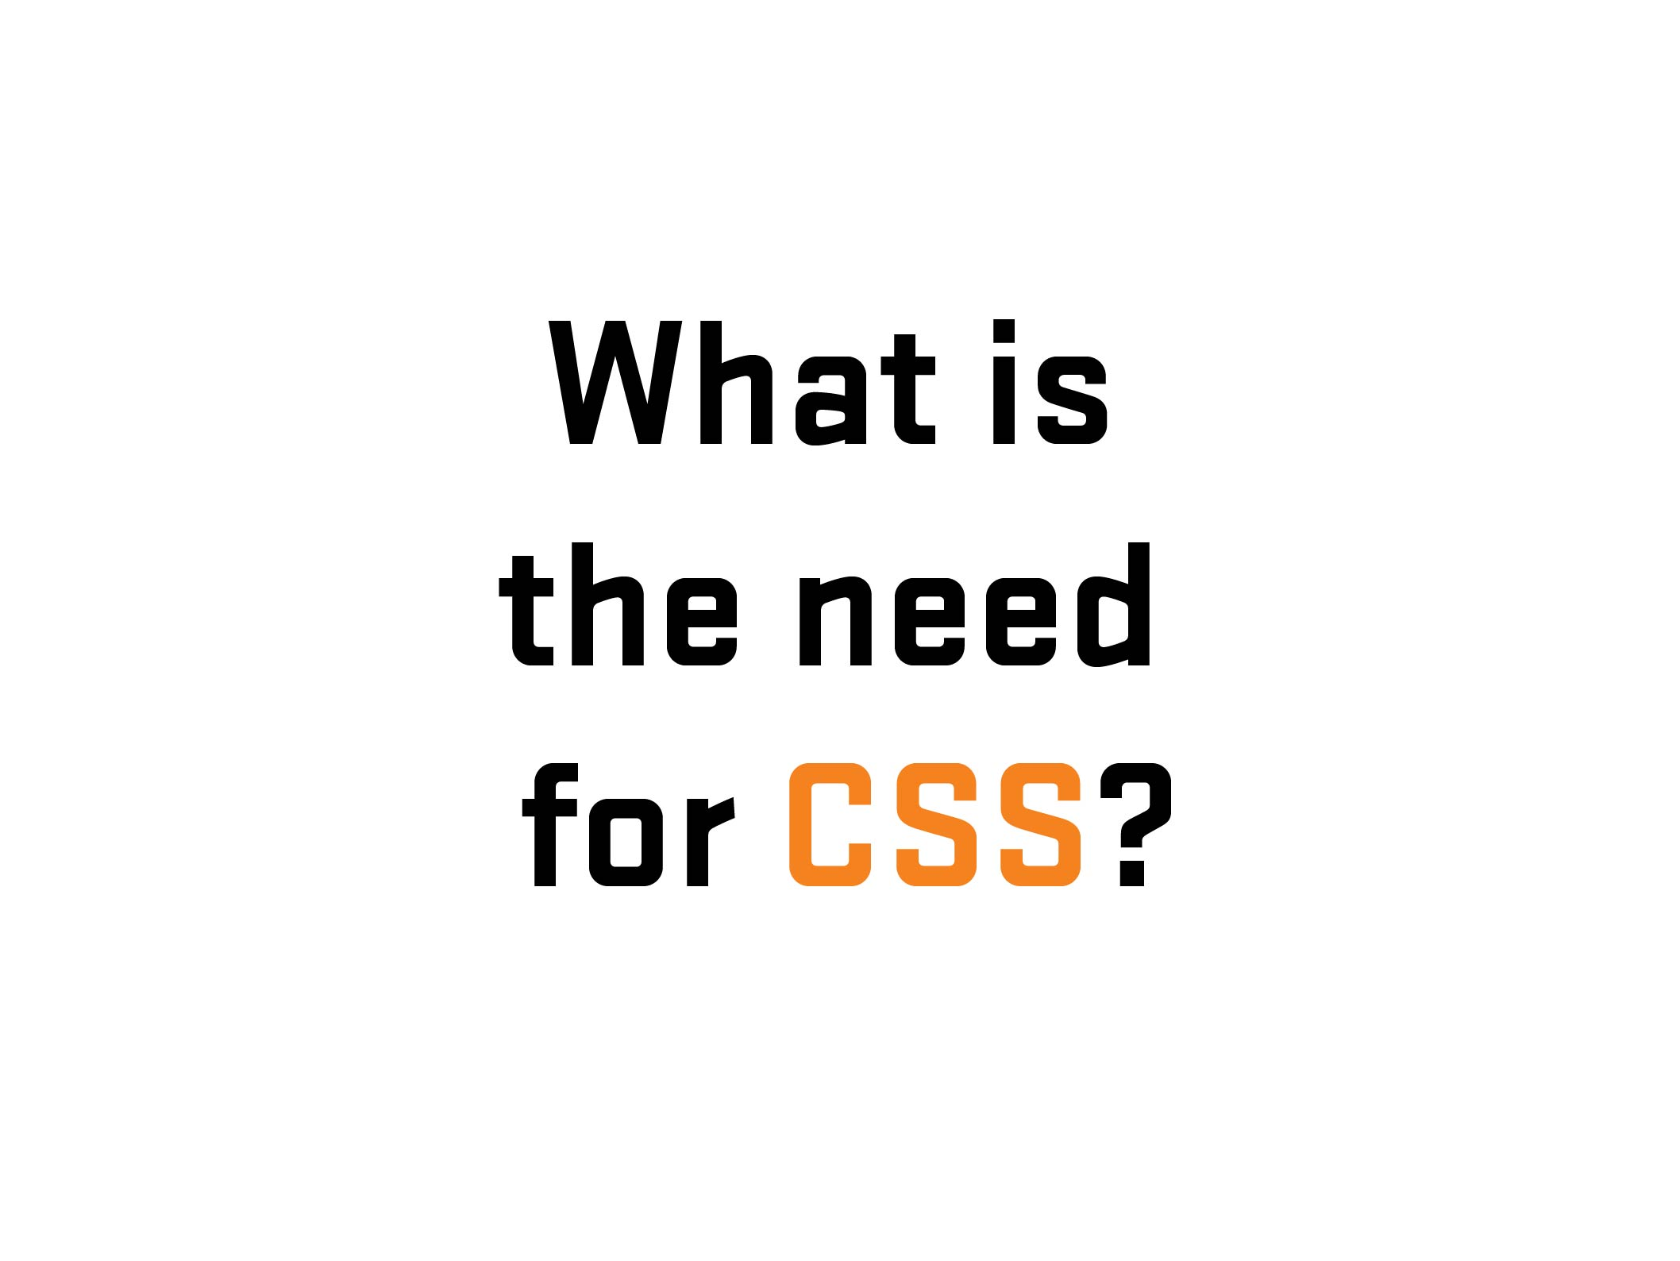
Notes:
43

Slide 44

Notes:
44

Slide 45
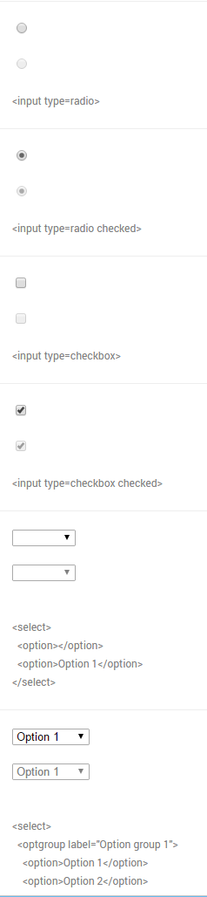
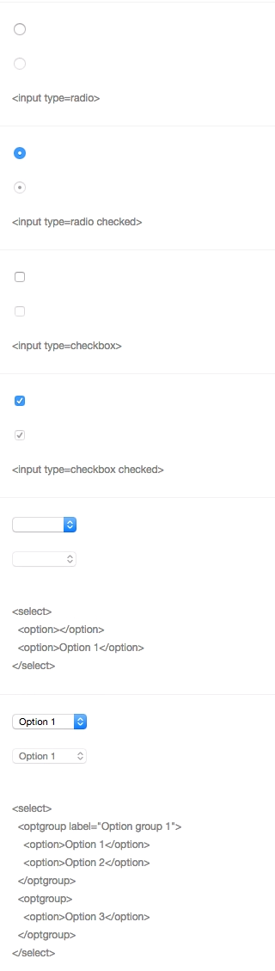
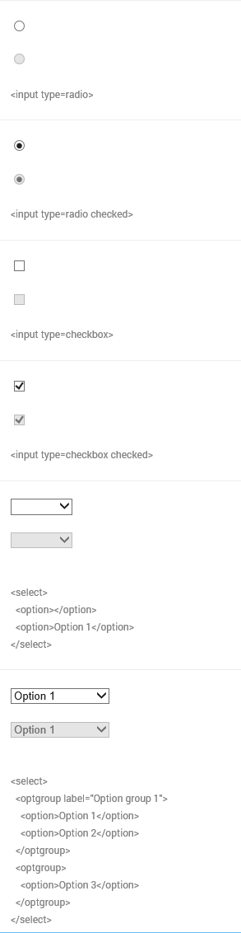
Chrome
Windows 10
Chrome
Yosemite
IE 11
Windows 10
Notes:
45
Differences of form UI’s among browsers/platforms
45

Slide 46
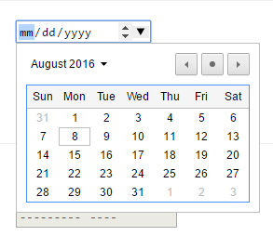
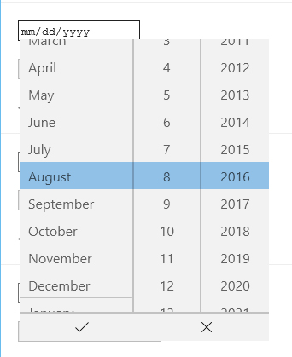
Chrome
Windows 10
Edge
Windows 10
Notes:
46
Another example – Date input (different look/functionality/UI) – Desktop
Go to nativeformelements.com for brief demo
46

Slide 47
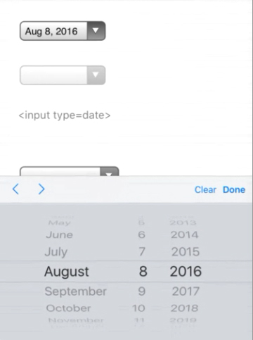
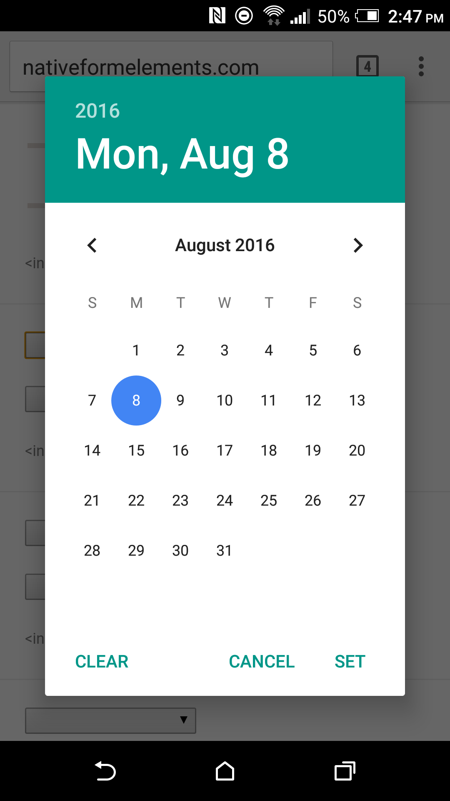
iPhone 6S Plus
iOS 9
HTC One M8
Android Marshmellow (6)
Notes:
47
Another example – Date input (different look/functionality/UI) - Mobile
47

Slide 48
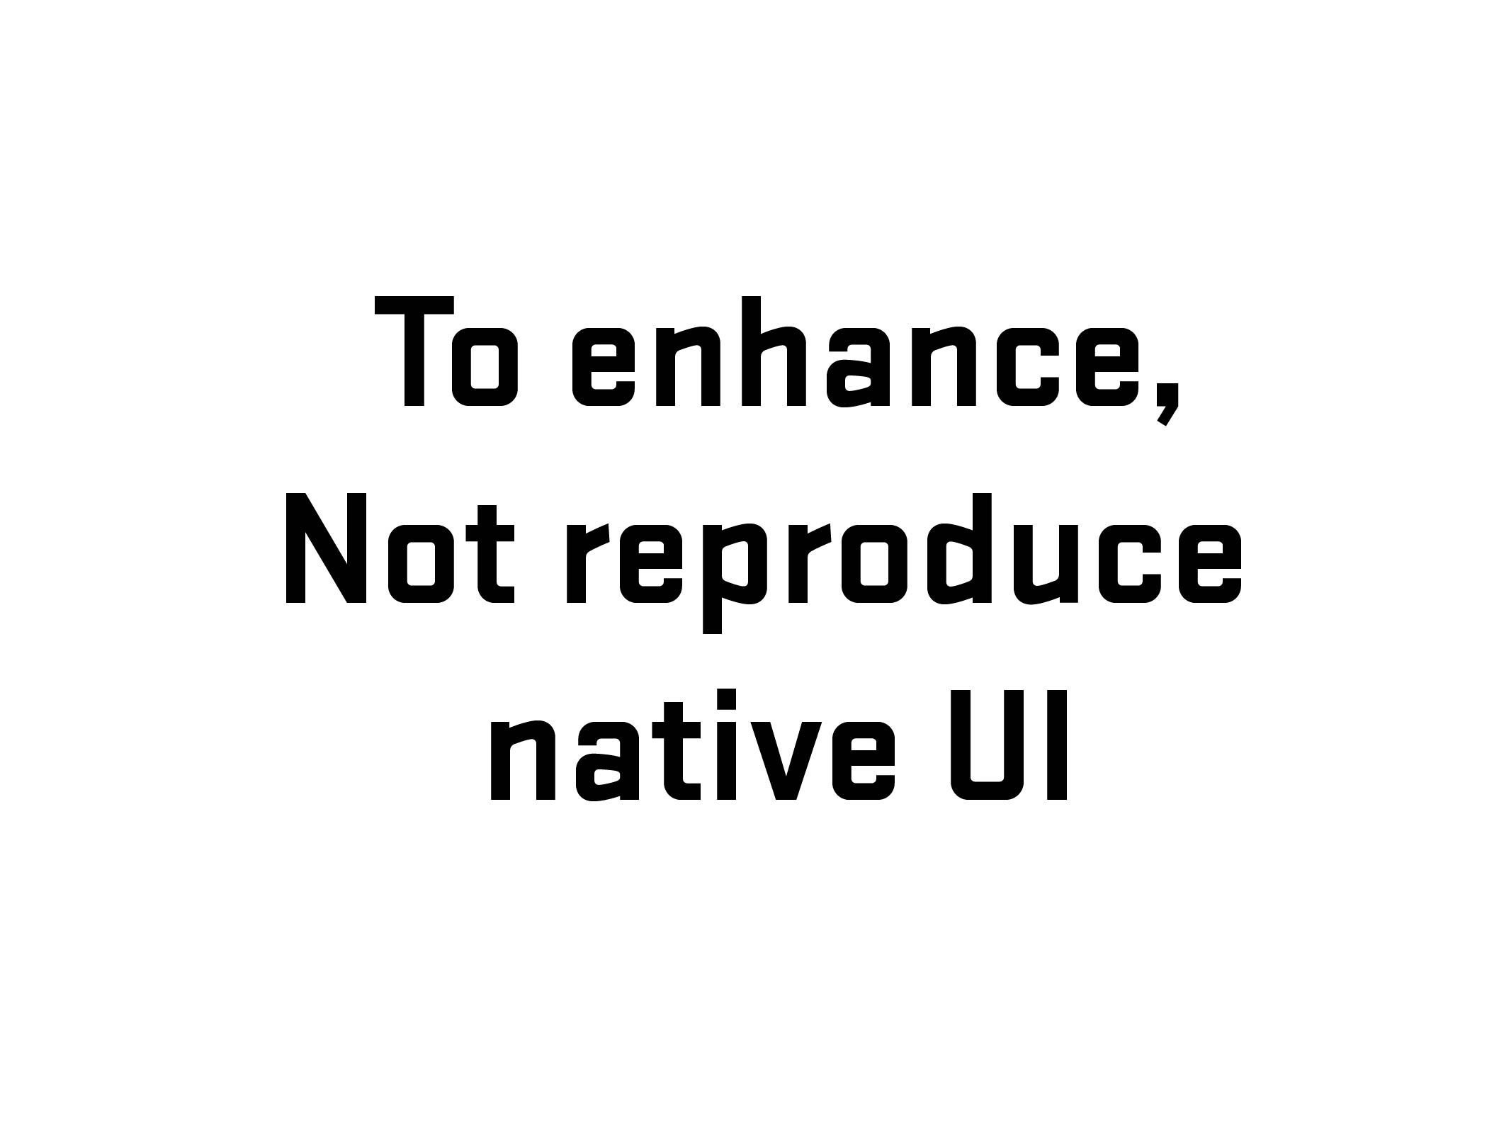
Notes:
48
Explanation
GEICO Story (2008-09)
48

Slide 49
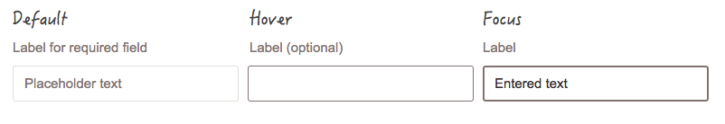

Slide 50
Notes:
50
Before going further – 1) explain what labels are and 2) what is that difference between placeholder and labels (and why that is important)
50

Slide 51
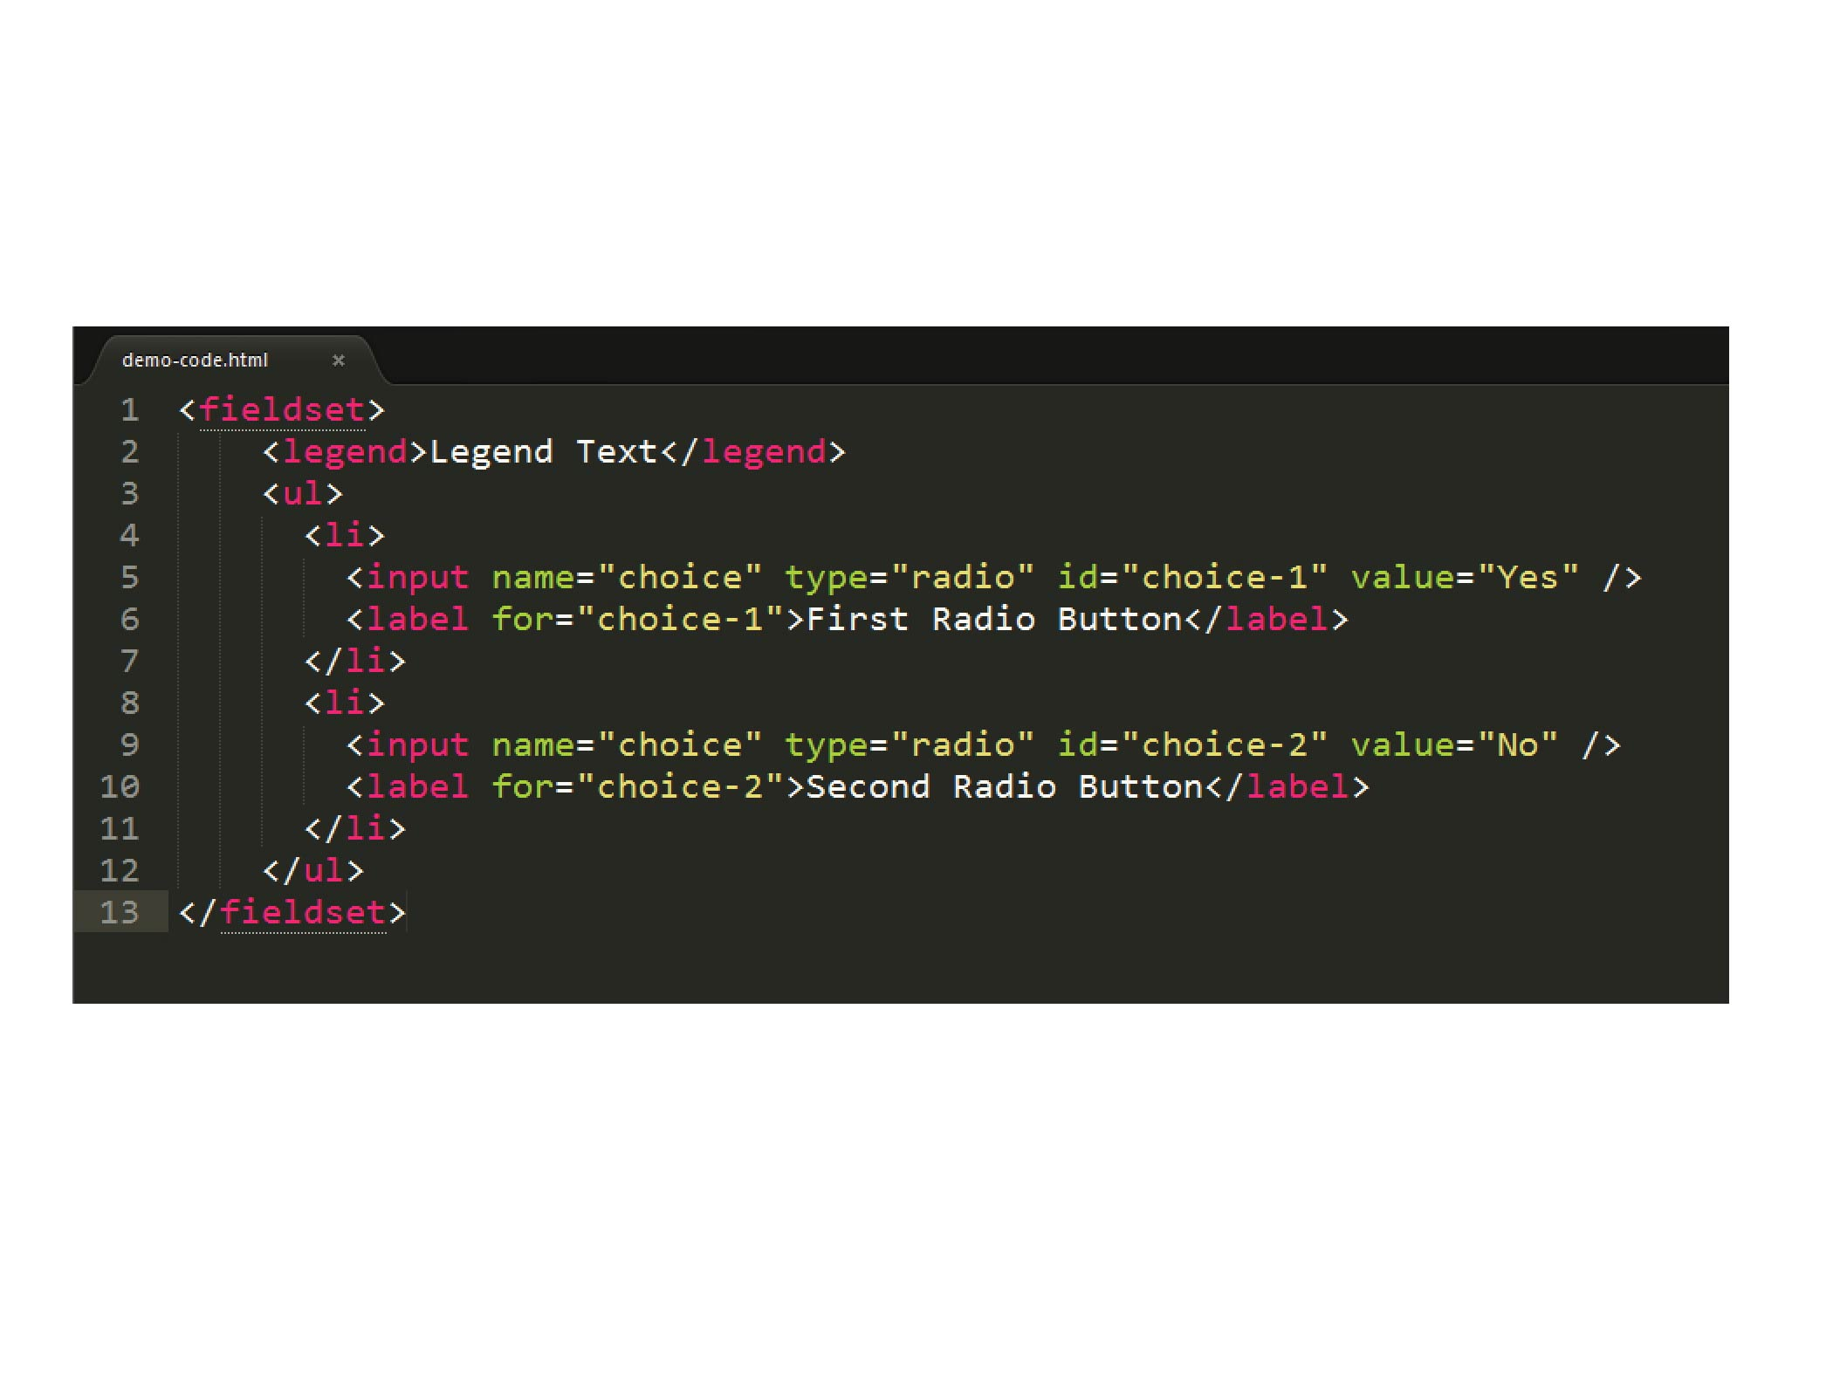


Slide 52
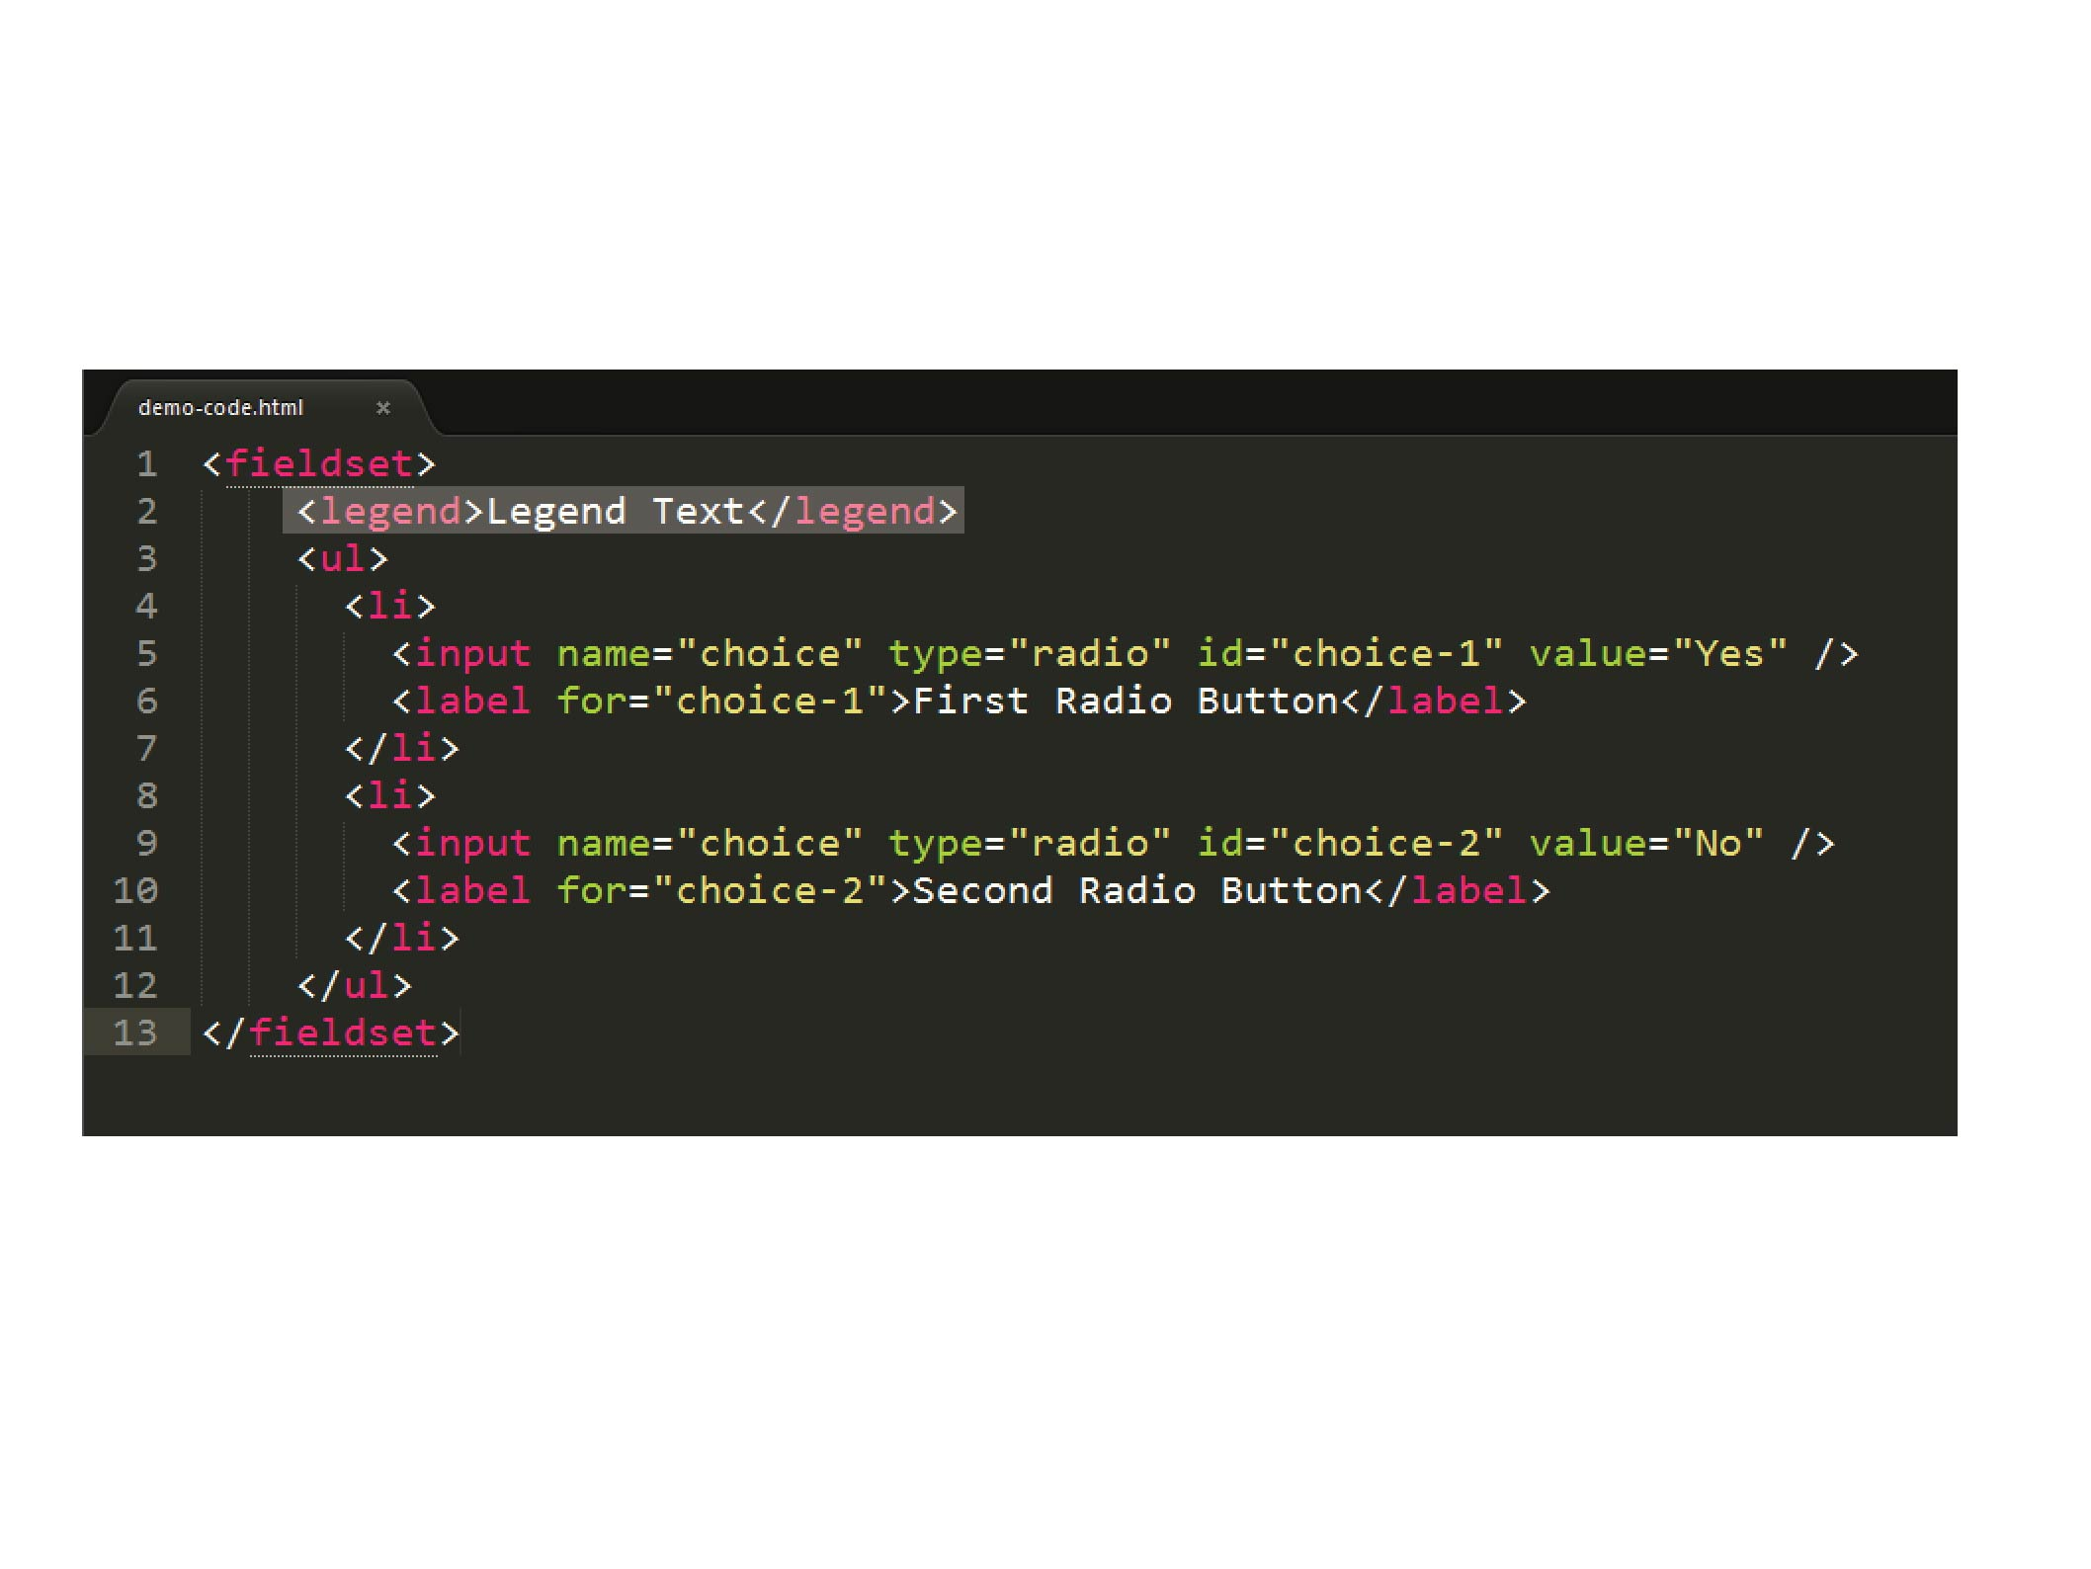

Slide 53
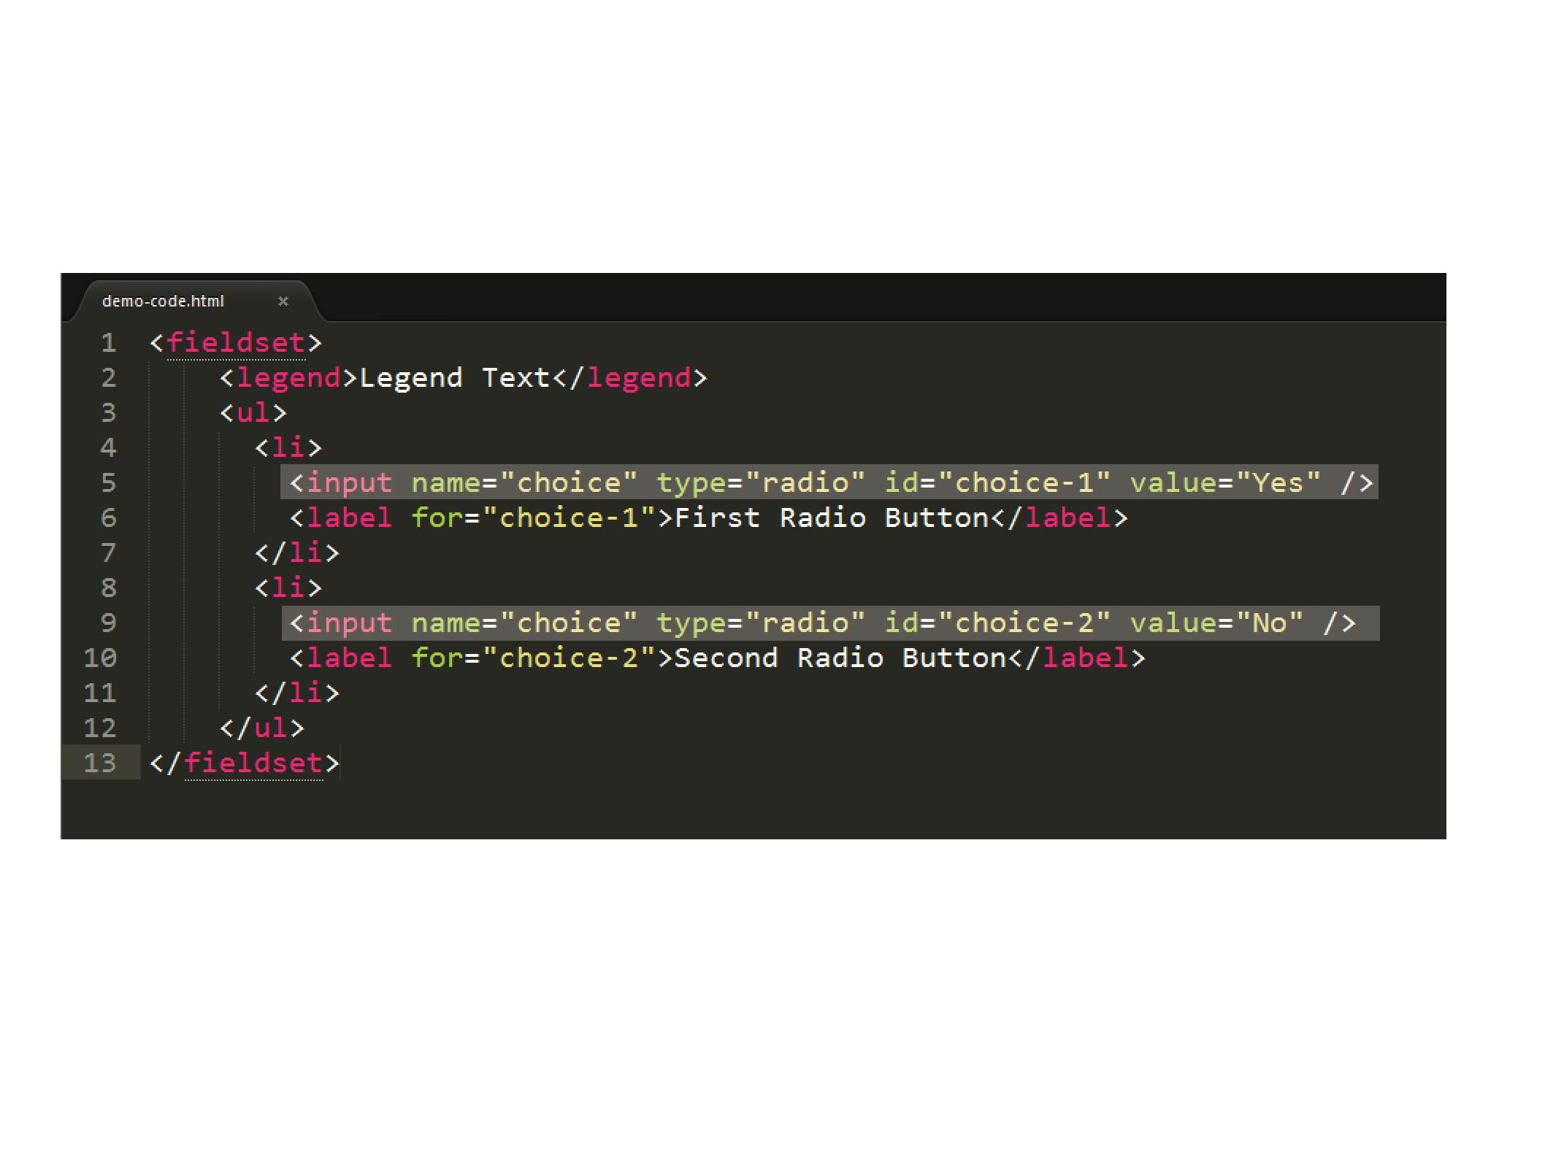

Slide 54
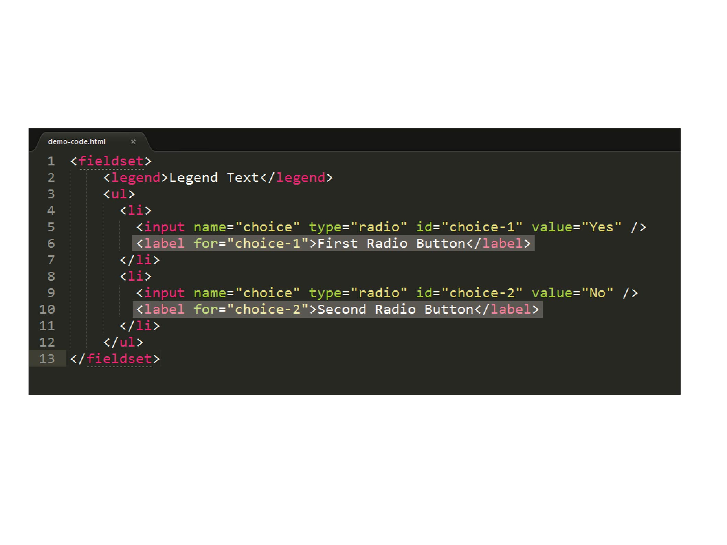

Slide 55
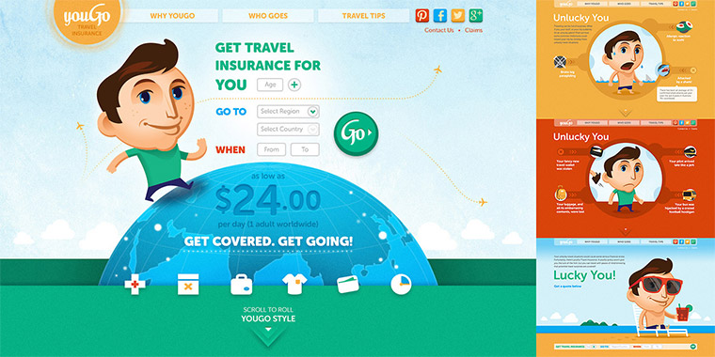
Notes:
55
youGo – travel insurance for under 30 crowd/Cover-More
55

Slide 56
Notes:
56
56
youGo/unlucky explanation – Visual (Choice #1)
Form with four set of radio buttons – no submit
(demo form)
Go to youGo site for demo - http://yougotravelinsurance.com.au/

Slide 57

Notes:
57
57
youGo/unlucky explanation – Visual/Code (Choice #1)

Slide 58

Notes:
58
58
youGo/unlucky explanation – Visual/Code (Choice #1)

Slide 59

Notes:
59
59
youGo/unlucky explanation – Visual/Code (Choice #1)

Slide 60

Notes:
60
60
youGo/unlucky explanation – Visual/Code (Choice #1)

Slide 61


Notes:
61
61
youGo/unlucky explanation – Visual/Code (Choice #1)

Slide 62


Slide 63



Slide 64

Notes:
64
Solved problem with two prong/server page approach – one desktop/one mobile. Which is an viable option (see McGrane/adaptive solutions). But at the time, it had hiccups (serving wrong page, etc.). Not a mess but not an ideal (responsive) solution.
64

Slide 65

Notes:
65
If I had a chance, what would I do…
So I wrote some notes…
65

Slide 66


Notes:
66
First thing, change the codebase (responsive/reduced JS/a11y?)
Allowed for direct data input (no JS)
Single code base (responsive)
A11y???
66

Slide 67

Notes:
67
Going back to the base – information language
67

Slide 68

Notes:
68

Slide 69

Notes:
69

Slide 70

Notes:
70

Slide 71

Notes:
71
71

Slide 72

Notes:
72

Slide 73

Notes:
73
No JS in data entry – used for display/toggle
73

Slide 74
.ui-countryselector input[type="radio"]
+ label ~ div.columns {
overflow: hidden;
float: none;
position: absolute;
clip: rect(0,0,0,0);
width: 100%;
height: 0;
margin: 0;
padding: 0;
}
Notes:
74
74

Slide 75
If a region is not selected,
hide related countries
Notes:
75
75

Slide 76
If a region is selected,
show related countries
Notes:
76
76

Slide 77
.ui-countryselector input[type="radio"]:checked
+ label ~ div.columns {
position: static;
height: auto;
}
Notes:
77
77

Slide 78
.ui-countryselector input[type="radio"] + label ~ div.columns { overflow: auto; }
Notes:
78
78

Slide 79

.ui-countryselector input[type="radio"]:checked + label ~ div.columns { float: left; height: 384px; }
Notes:
79
Note – hard to do due to bugs. Adjacent bug in both iOS (“+” didn’t work) and Android (needed fix). Thankfully, fixed in more recent versions.
79

Slide 80

Notes:
80
I found out during QA testing and was able to remove or work around some of the barriers.
80

Slide 81

Notes:
81
No excuse for not testing – getting problems out of the way. For the initial work, even had to test for Android 2.3…But the way, a moment of silence….
81

Slide 82

Notes:
82

Slide 83


Slide 84

Notes:
84

Slide 85

Notes:
85
85

